Slide 1
fMRI Quality Assessment Report
sub003 Complete Analysis

Slide 2
Processing Summary
Total scans processed: 4\n\n• 2mm Resolution (Pre-scan 2)\n TR: 1.4s, QA Images: 16, tSNR Images: 6\n\n• 2mm Resolution (Long TR)\n TR: 2s, QA Images: 16, tSNR Images: 6\n\n• 3mm Resolution\n TR: 1.4s, QA Images: 16, tSNR Images: 6\n\n• 2mm Resolution (Pre-scan 1)\n TR: 2.026s, QA Images: 16, tSNR Images: 6\n\n

Slide 3
2mm Resolution (Pre-scan 2)
TR: 1.4s | 2mm × 2mm × 2mm (Pre-scan 2) | QA Images: 16 | tSNR Images: 6

Slide 4
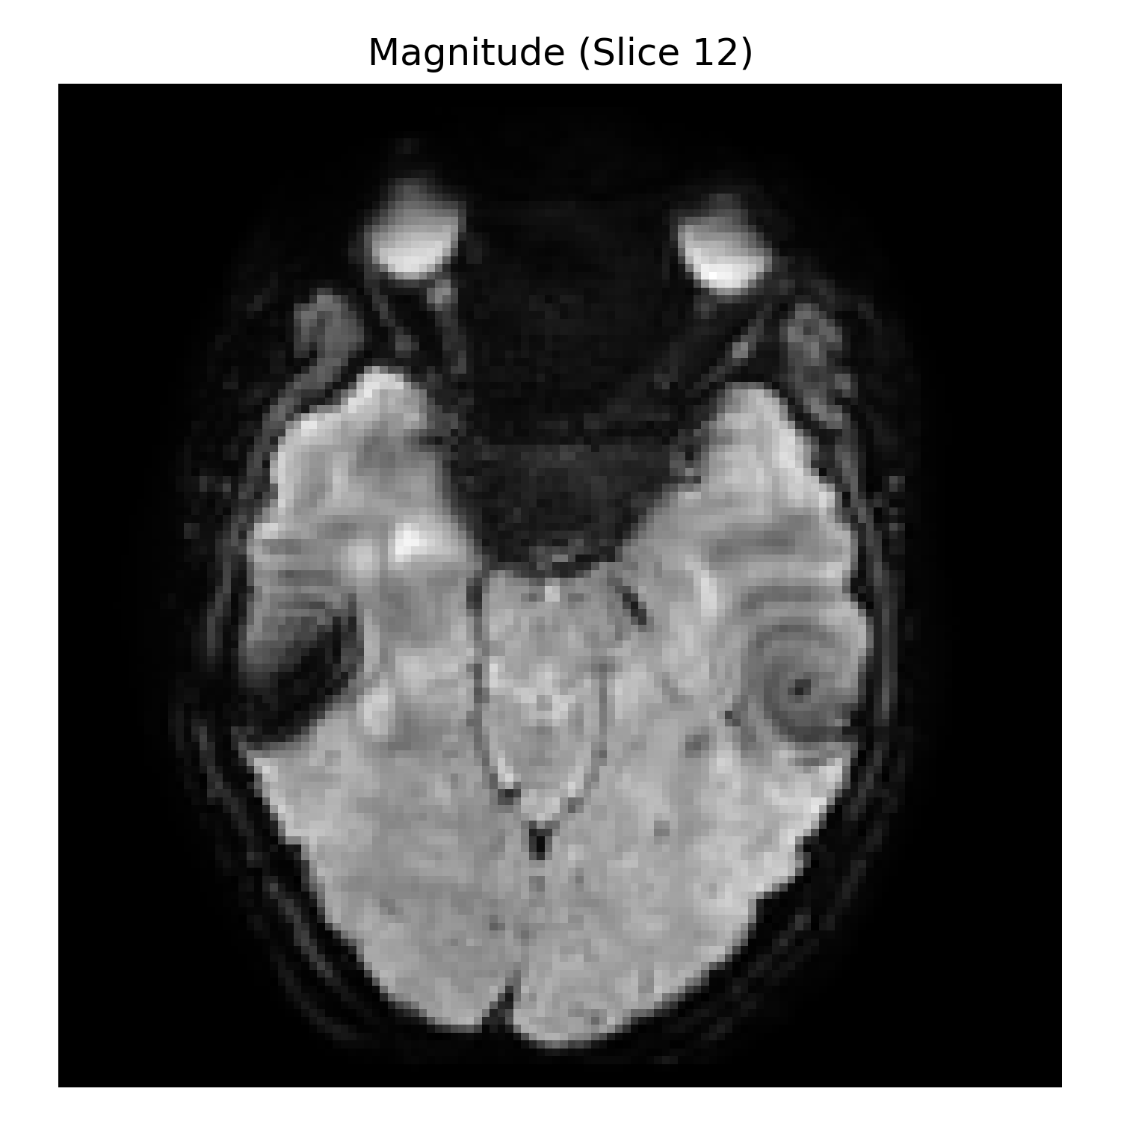
2mm Resolution (Pre-scan 2): Mean Signal Image

Slide 5
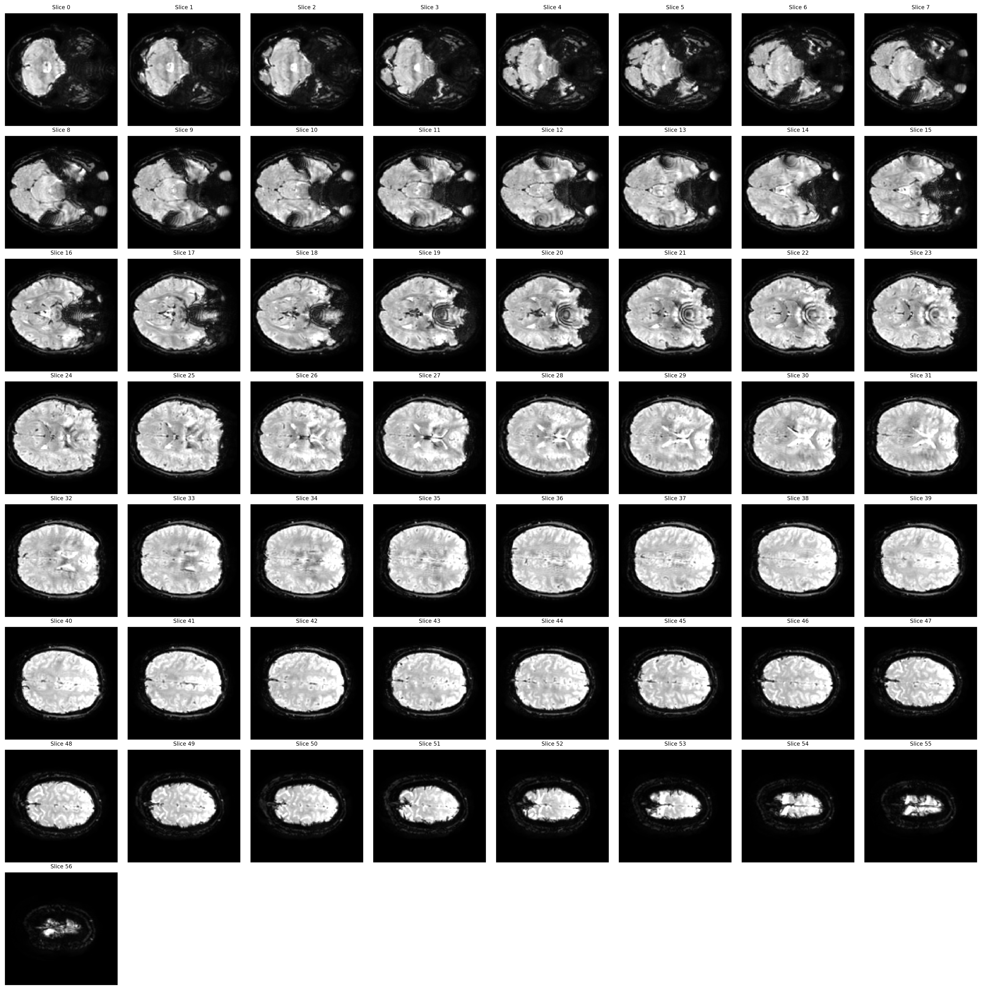
2mm Resolution (Pre-scan 2): Mean Signal Montage

Slide 6
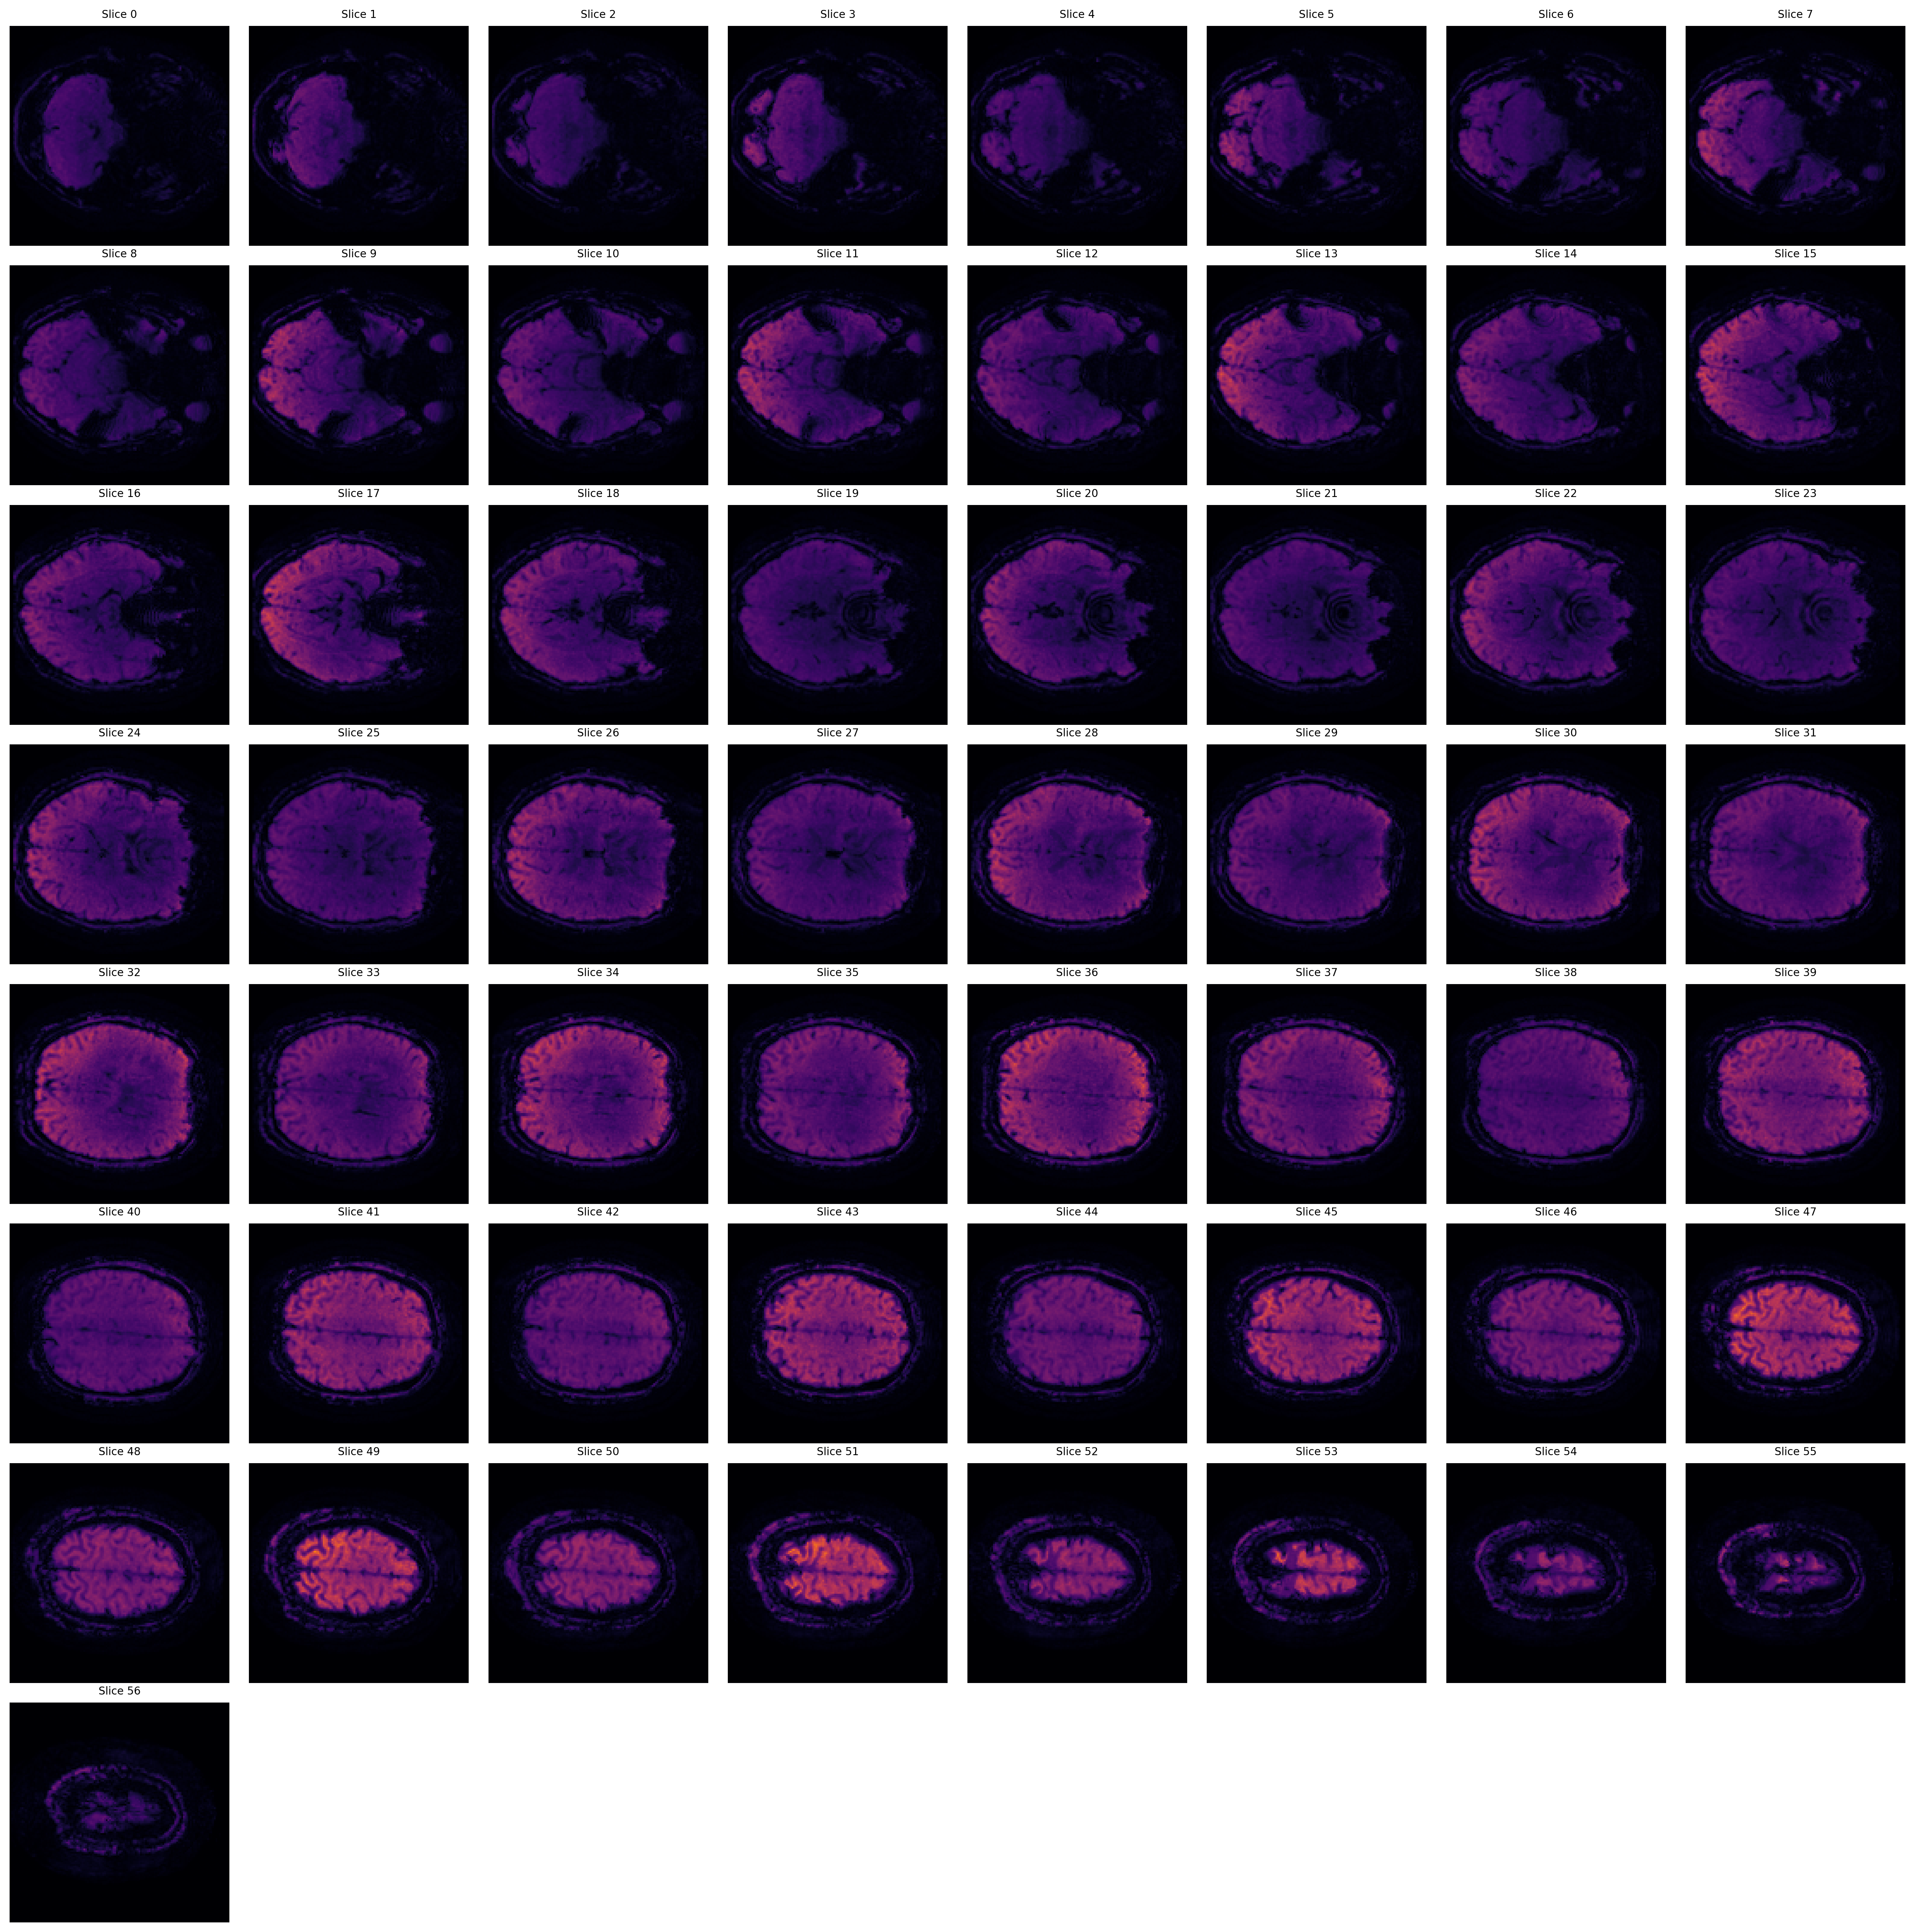
2mm Resolution (Pre-scan 2): Temporal SNR Montage (Orange)
Orange/Red colors indicate higher temporal SNR values. Brighter regions show better signal stability over time.

Slide 7
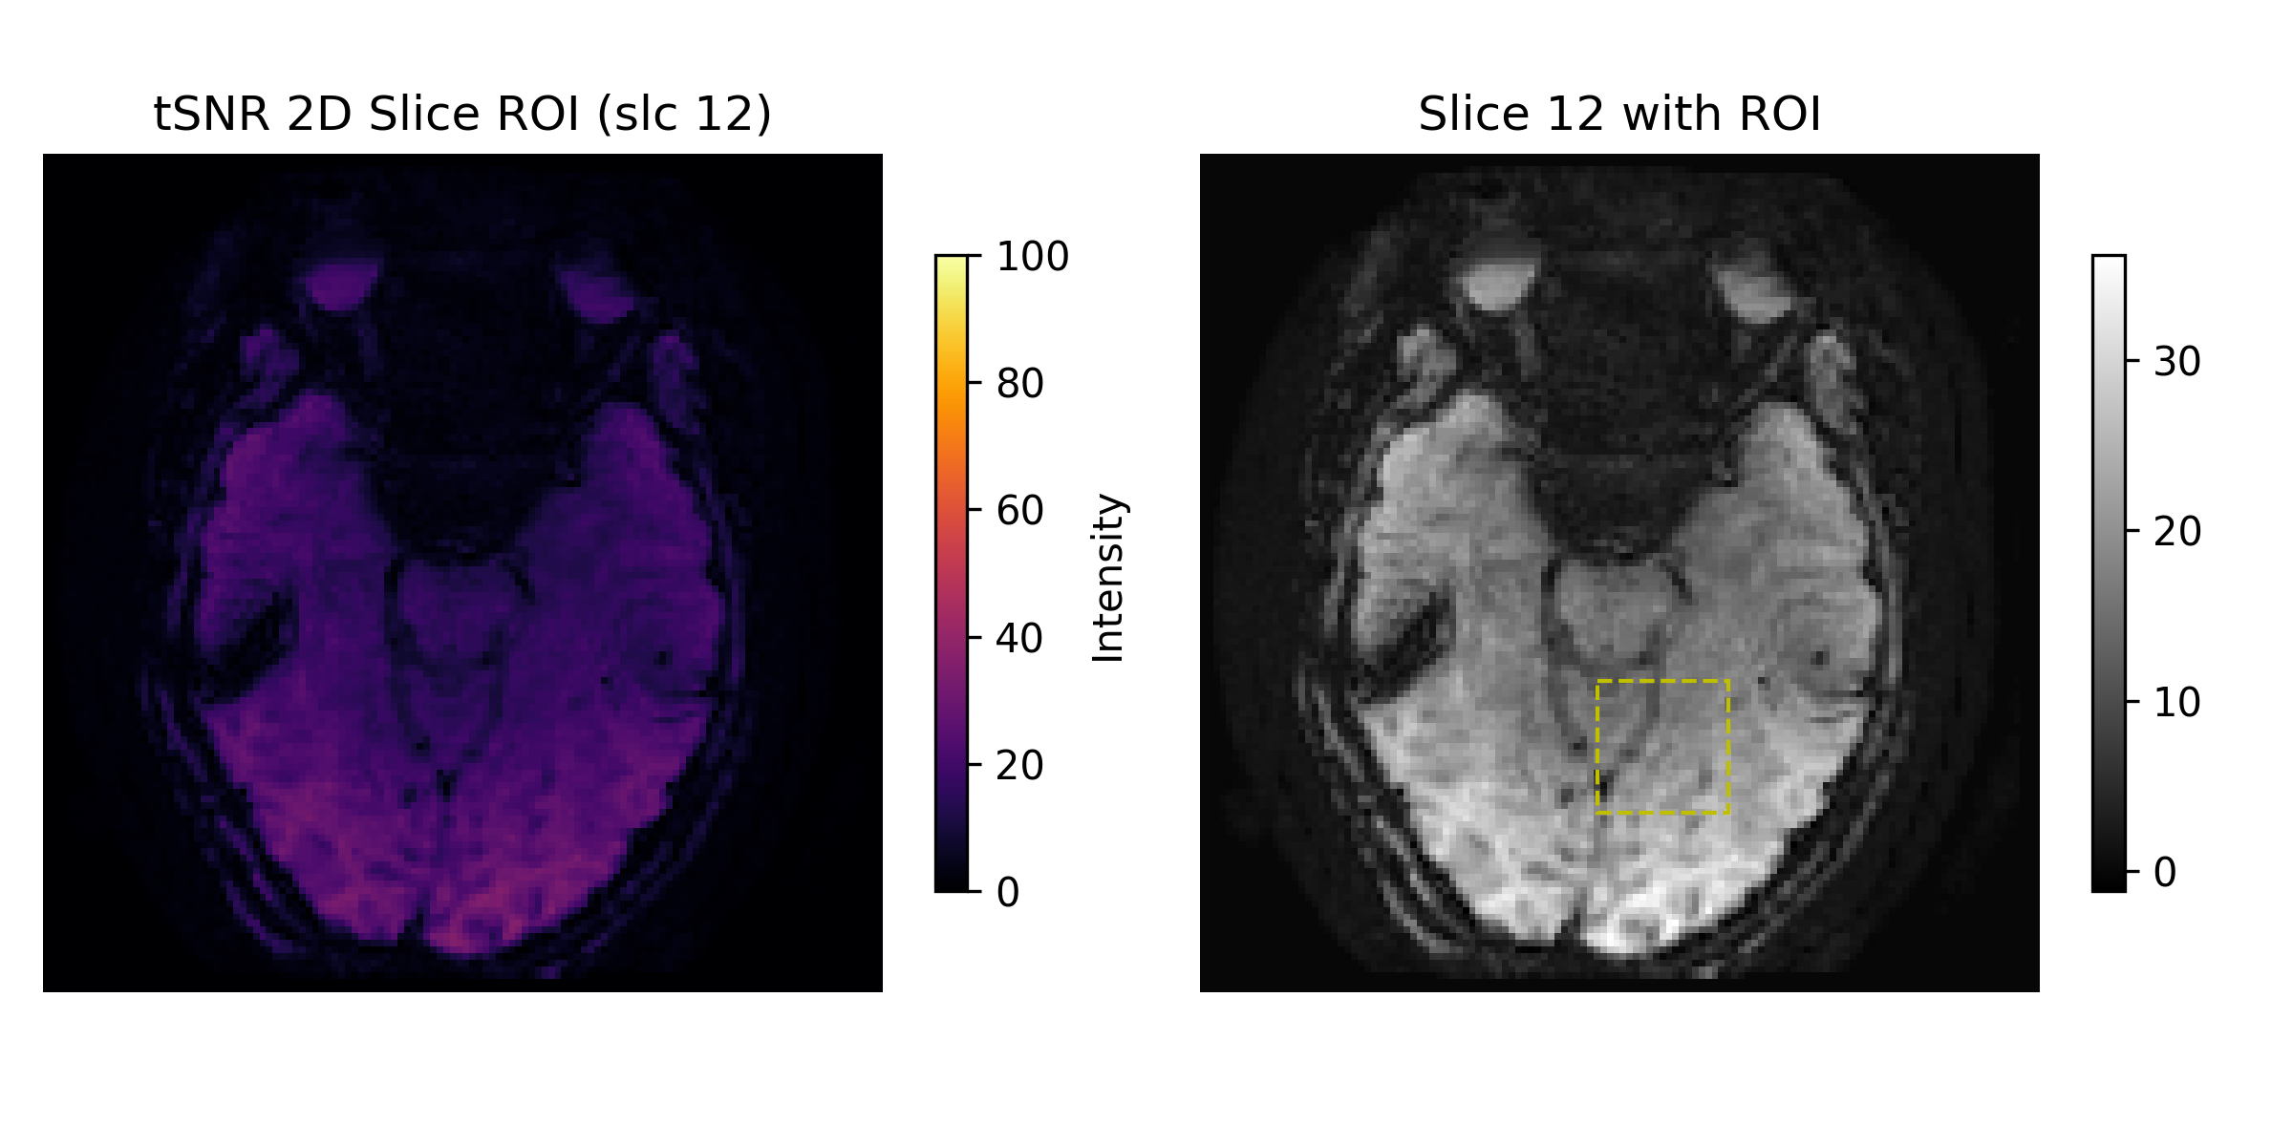
2mm Resolution (Pre-scan 2): tSNR with ROI Analysis
Temporal SNR analysis with Region of Interest overlay showing quantitative measurements.

Slide 8
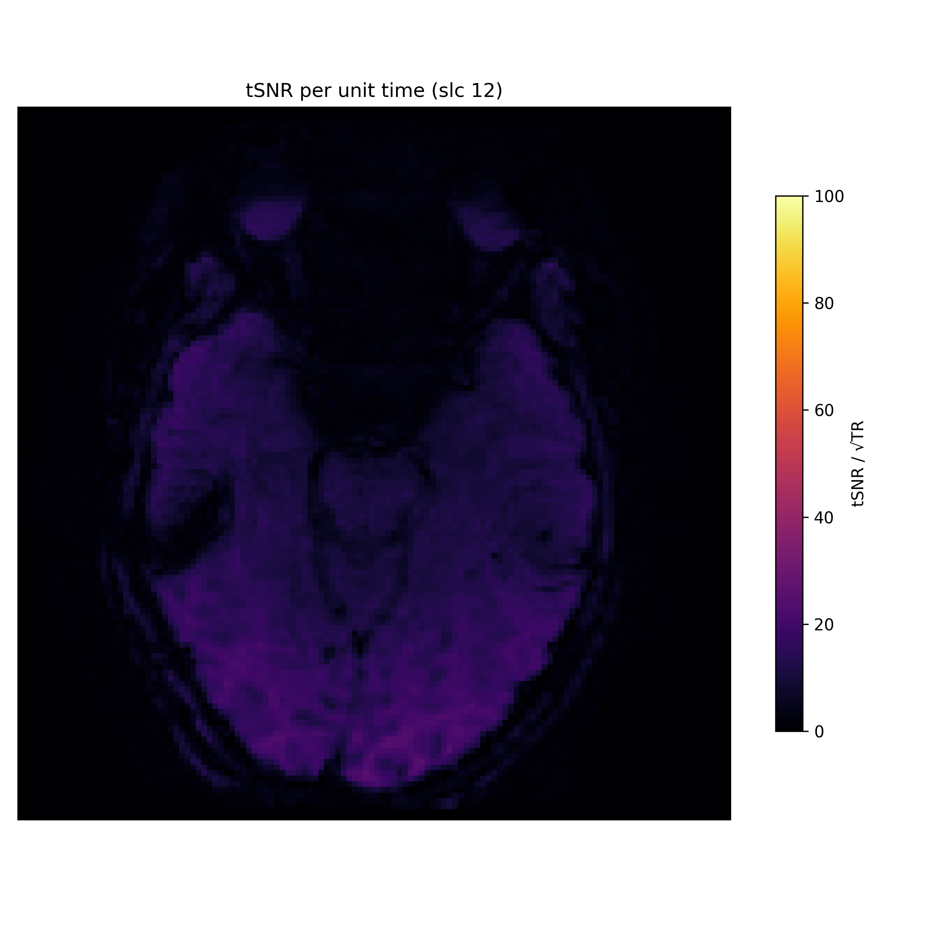
2mm Resolution (Pre-scan 2): tSNR per Unit Time
Temporal SNR normalized per unit time (TR=1.4s). Accounts for different repetition times.

Slide 9
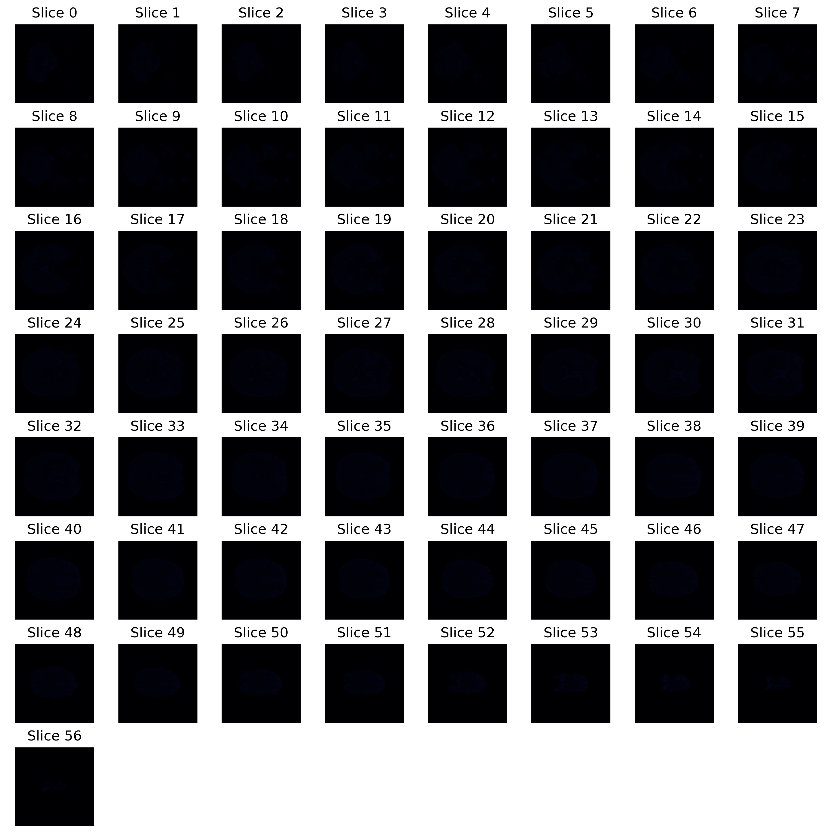
2mm Resolution (Pre-scan 2): Instantaneous SNR Montage
Instantaneous SNR montage showing spatial distribution of signal-to-noise ratio.

Slide 10
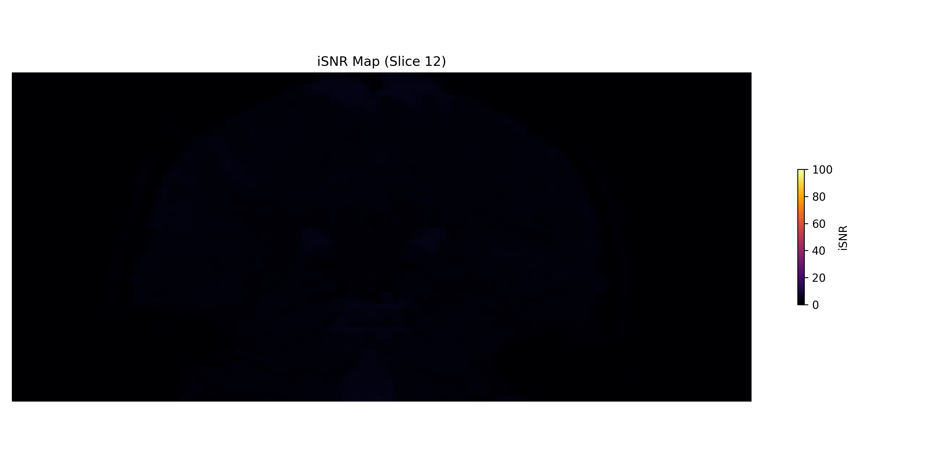
2mm Resolution (Pre-scan 2): iSNR Coronal View

Slide 11
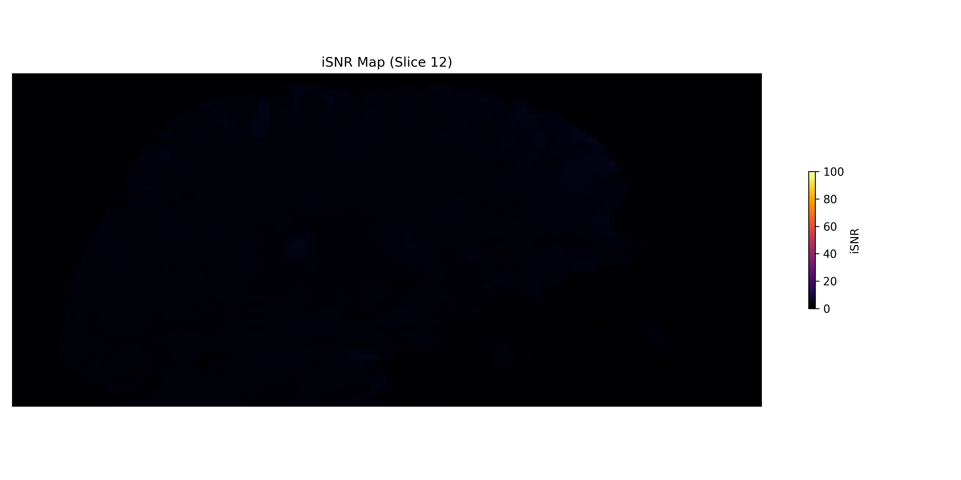
2mm Resolution (Pre-scan 2): iSNR Sagittal View

Slide 12
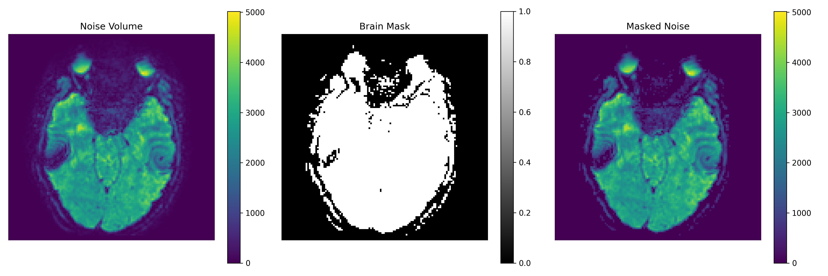
2mm Resolution (Pre-scan 2): Masked Noise Analysis

Slide 13
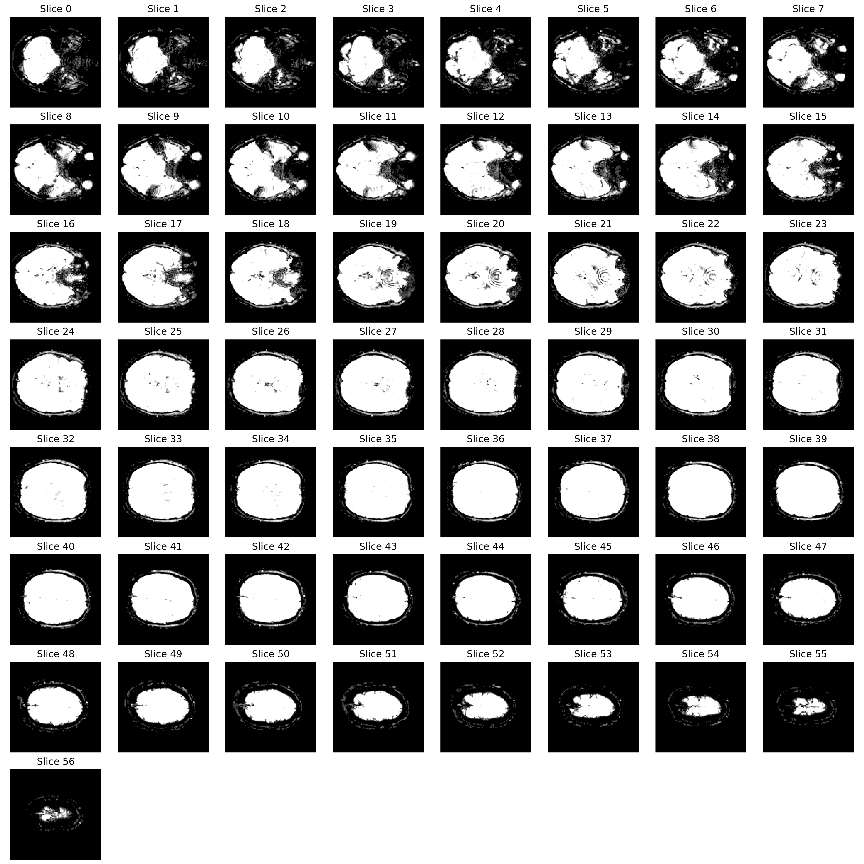
2mm Resolution (Pre-scan 2): Noise Volume Montage

Slide 14
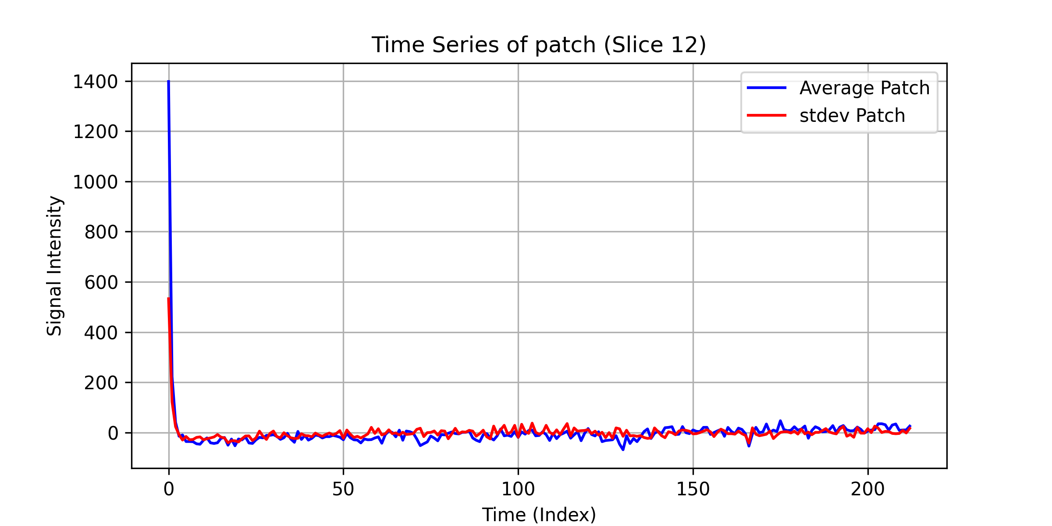
2mm Resolution (Pre-scan 2): Time Series Analysis

Slide 15
2mm Resolution (Long TR)
TR: 2s | 2mm × 2mm × 2mm (Long TR) | QA Images: 16 | tSNR Images: 6

Slide 16
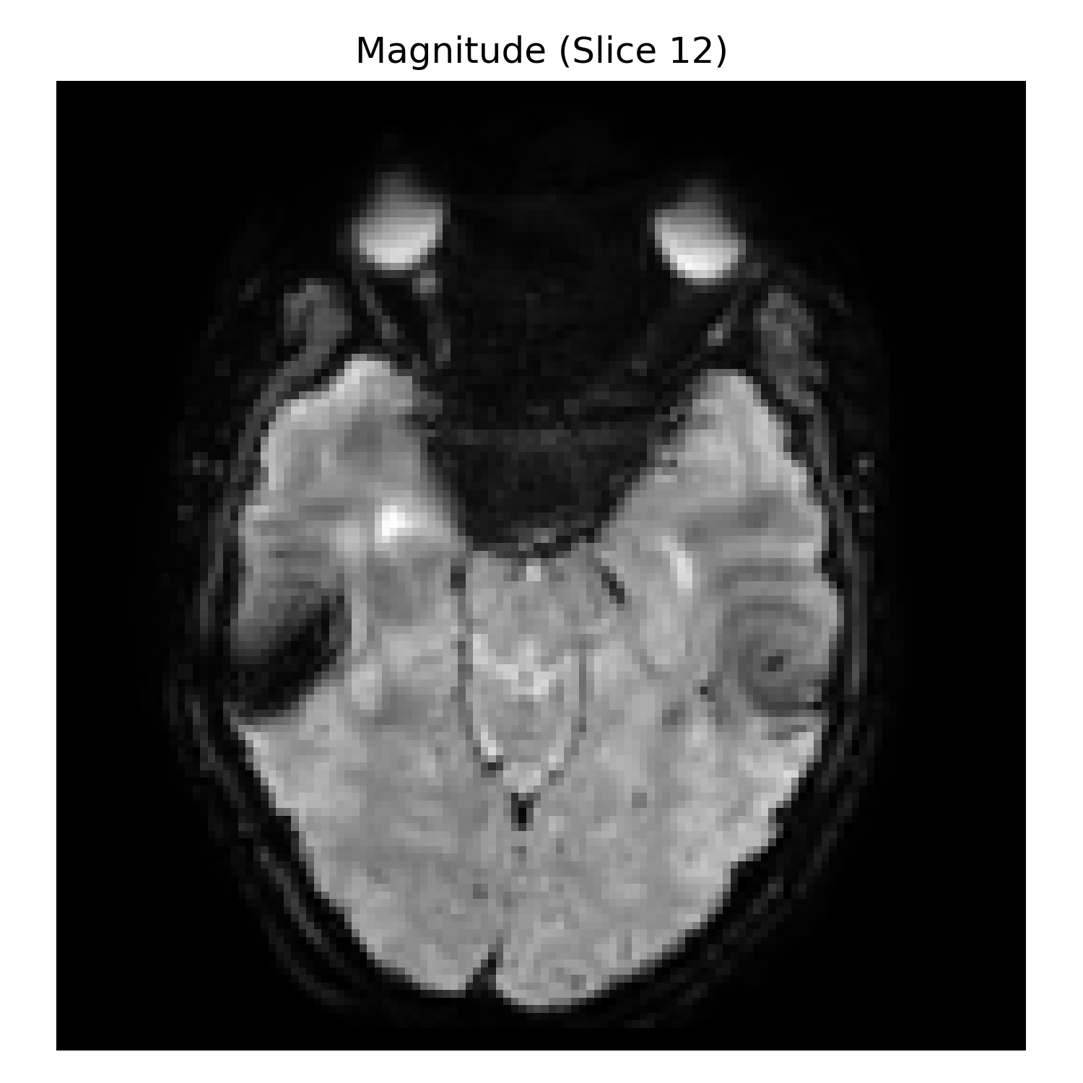
2mm Resolution (Long TR): Mean Signal Image

Slide 17

2mm Resolution (Long TR): Mean Signal Montage

Slide 18
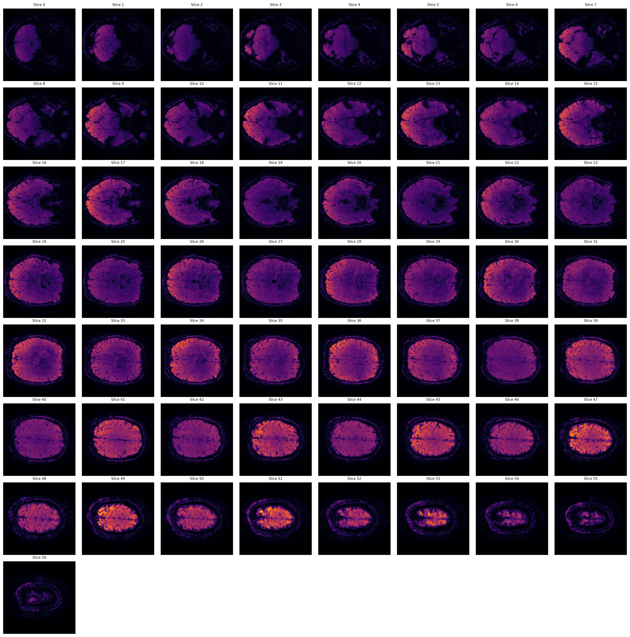
2mm Resolution (Long TR): Temporal SNR Montage (Orange)
Orange/Red colors indicate higher temporal SNR values. Brighter regions show better signal stability over time.

Slide 19
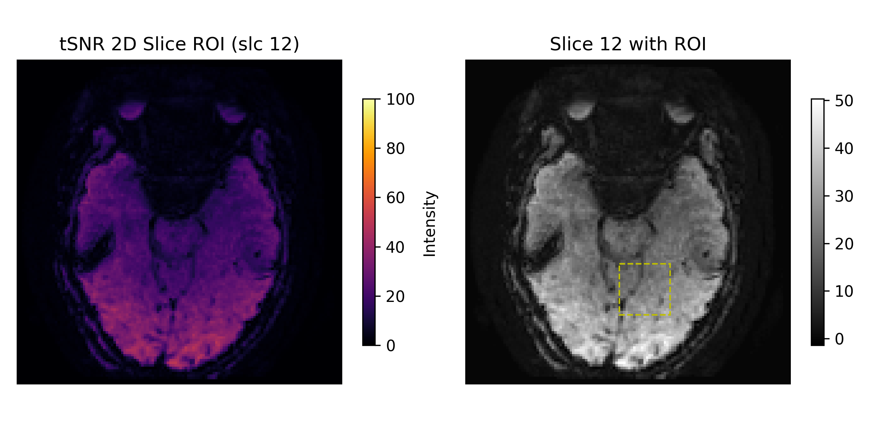
2mm Resolution (Long TR): tSNR with ROI Analysis
Temporal SNR analysis with Region of Interest overlay showing quantitative measurements.

Slide 20
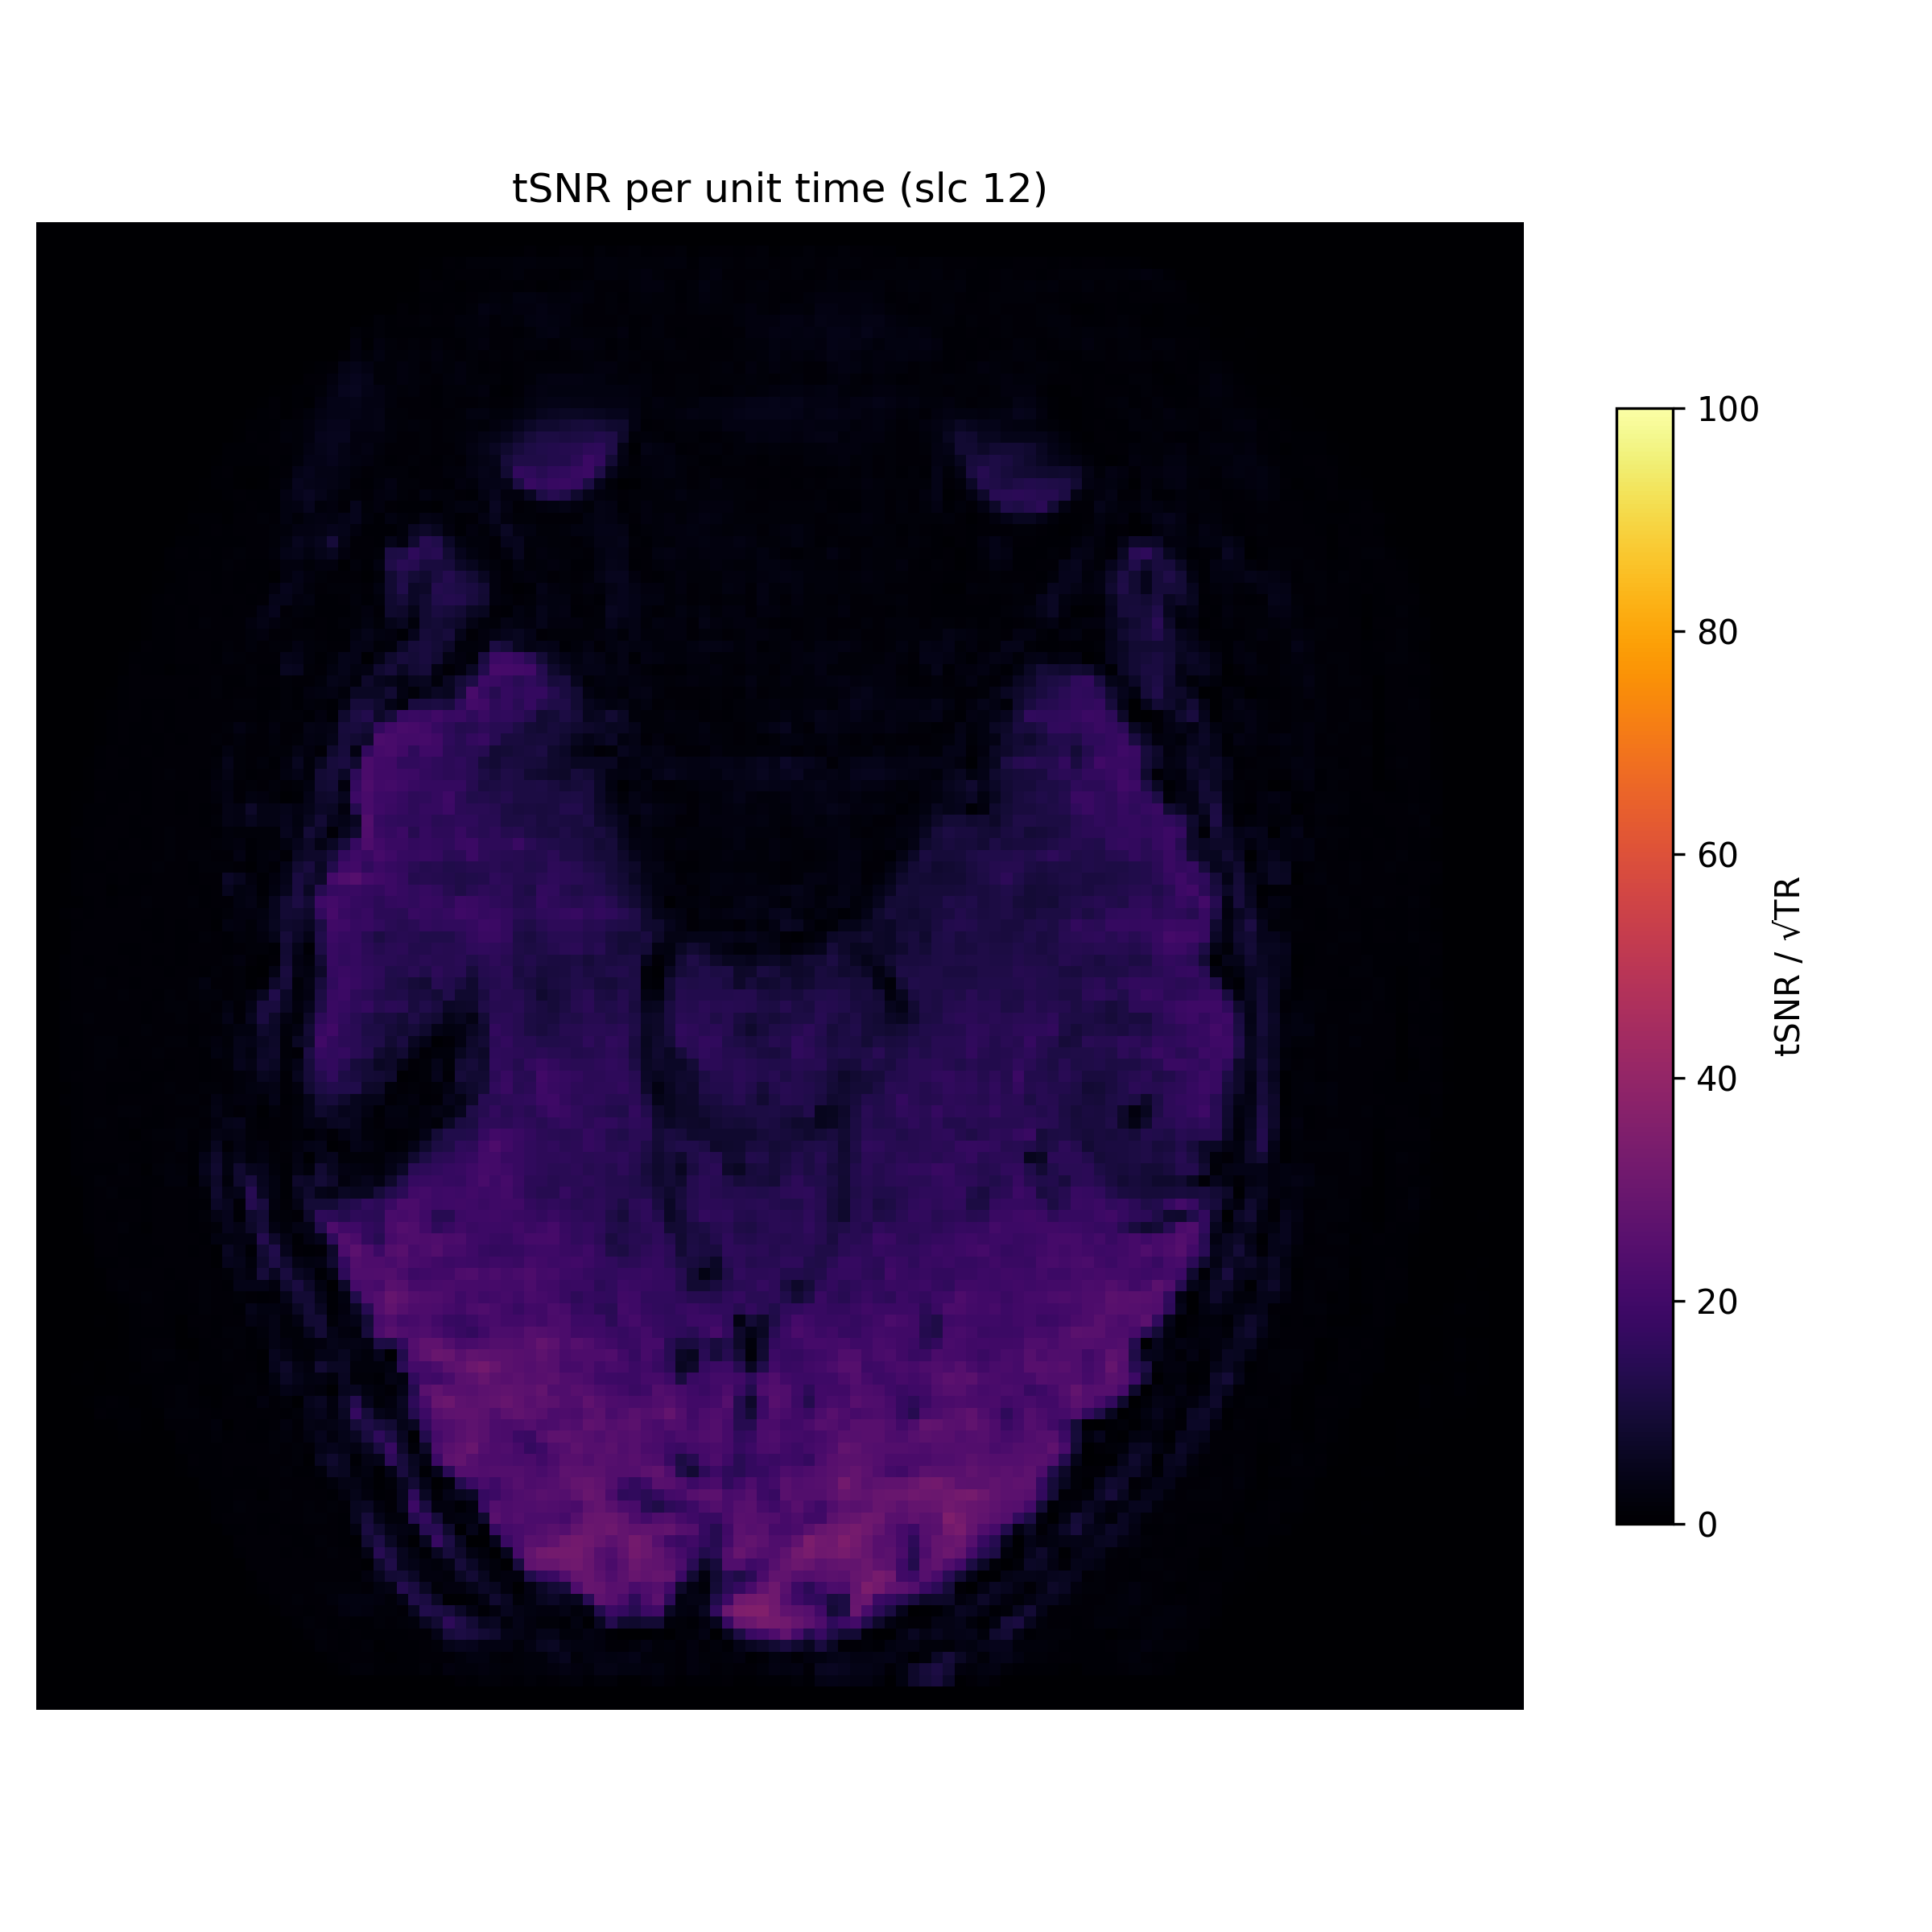
2mm Resolution (Long TR): tSNR per Unit Time
Temporal SNR normalized per unit time (TR=2s). Accounts for different repetition times.

Slide 21
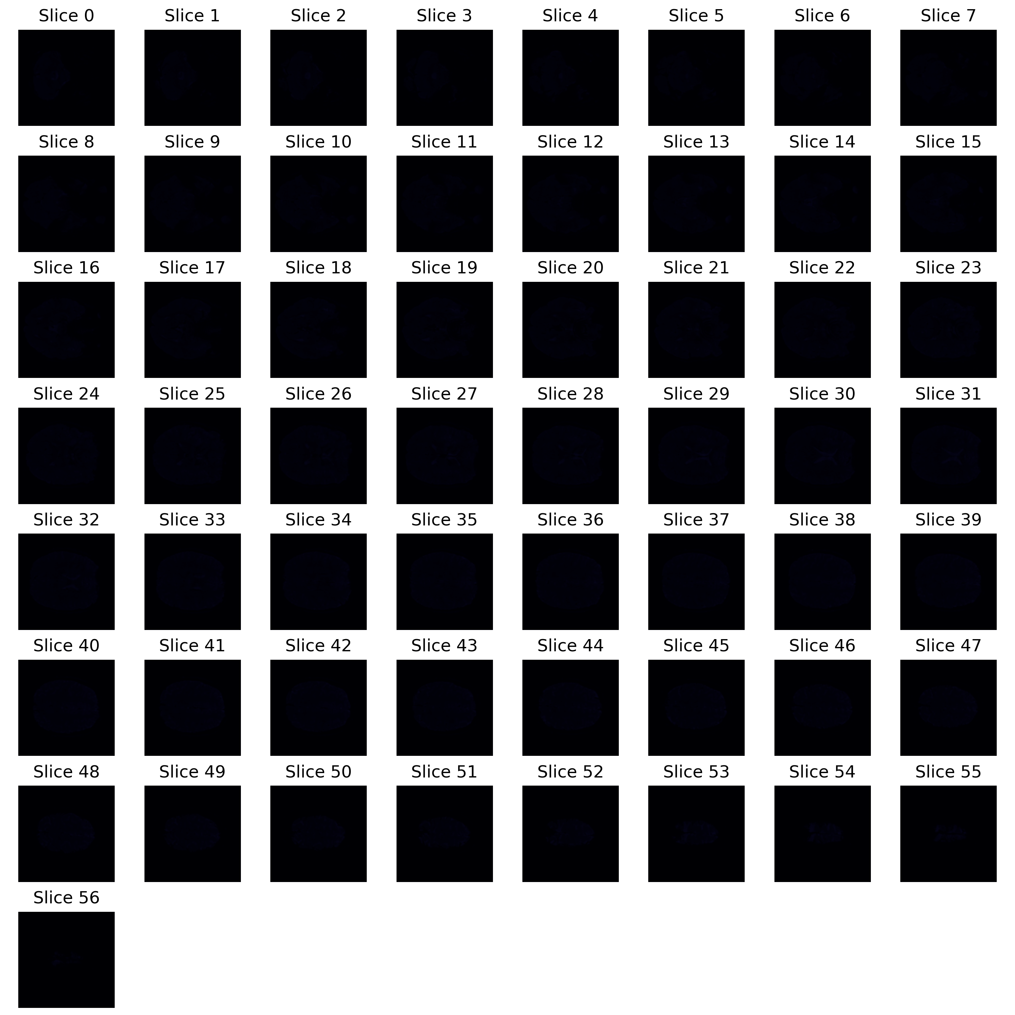
2mm Resolution (Long TR): Instantaneous SNR Montage
Instantaneous SNR montage showing spatial distribution of signal-to-noise ratio.

Slide 22

2mm Resolution (Long TR): iSNR Coronal View

Slide 23

2mm Resolution (Long TR): iSNR Sagittal View

Slide 24
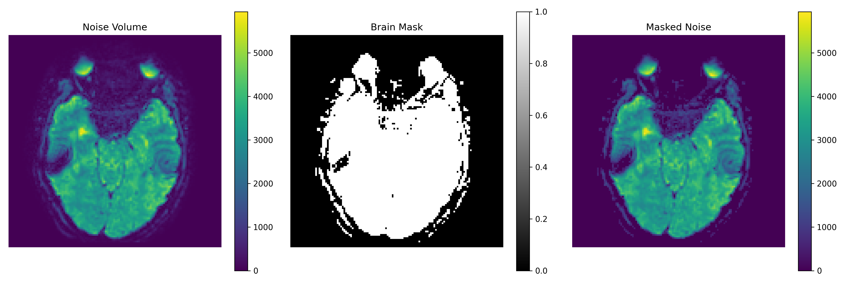
2mm Resolution (Long TR): Masked Noise Analysis

Slide 25

2mm Resolution (Long TR): Noise Volume Montage

Slide 26
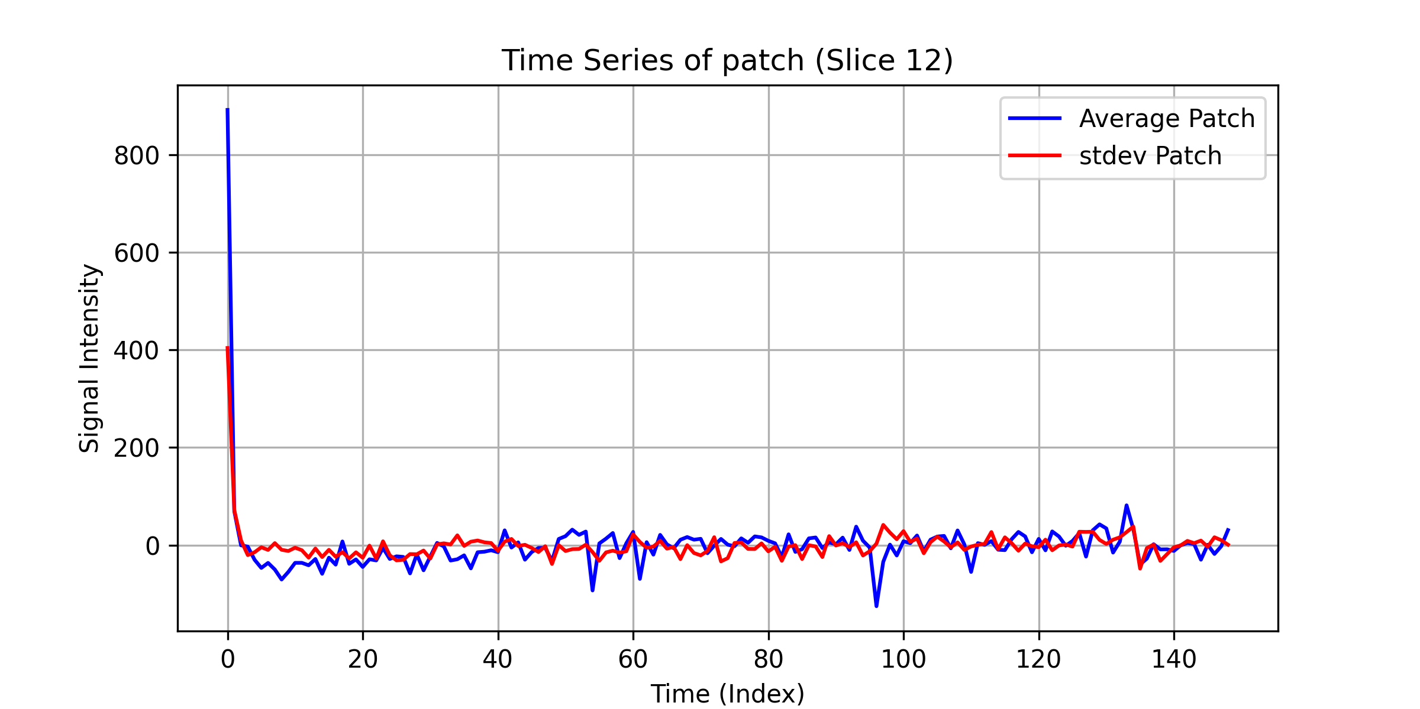
2mm Resolution (Long TR): Time Series Analysis

Slide 27
3mm Resolution
TR: 1.4s | 3mm × 3mm × 3mm | QA Images: 16 | tSNR Images: 6

Slide 28
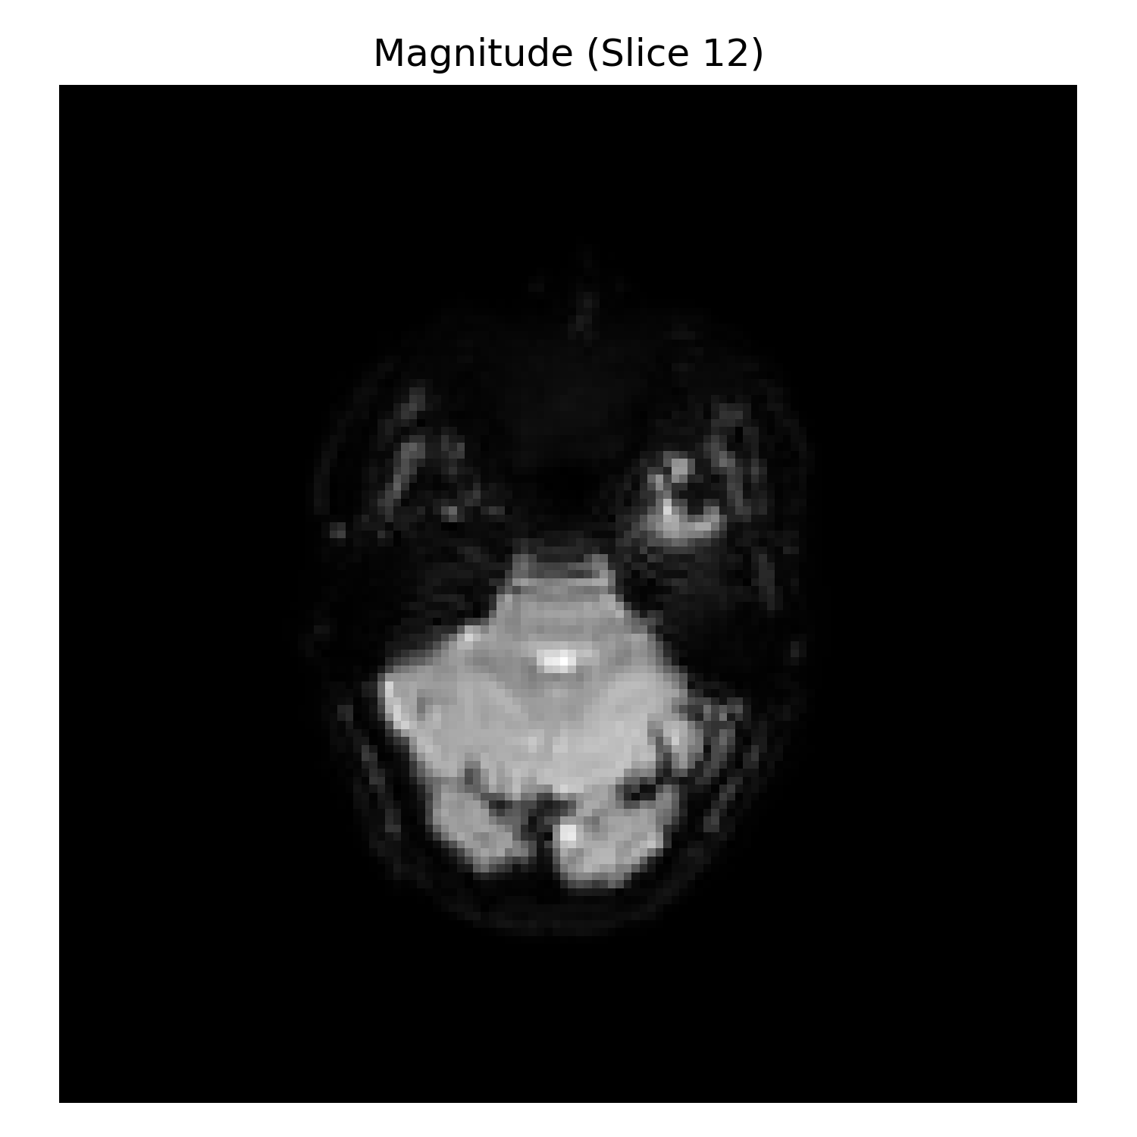
3mm Resolution: Mean Signal Image

Slide 29
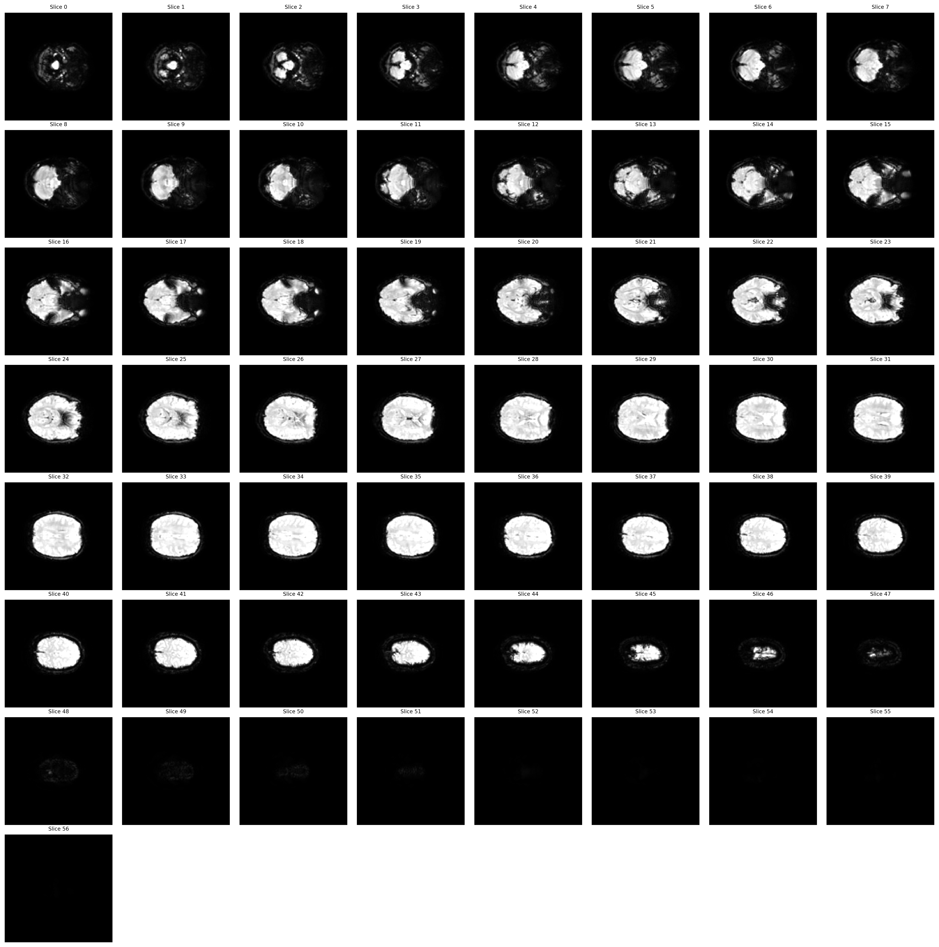
3mm Resolution: Mean Signal Montage

Slide 30
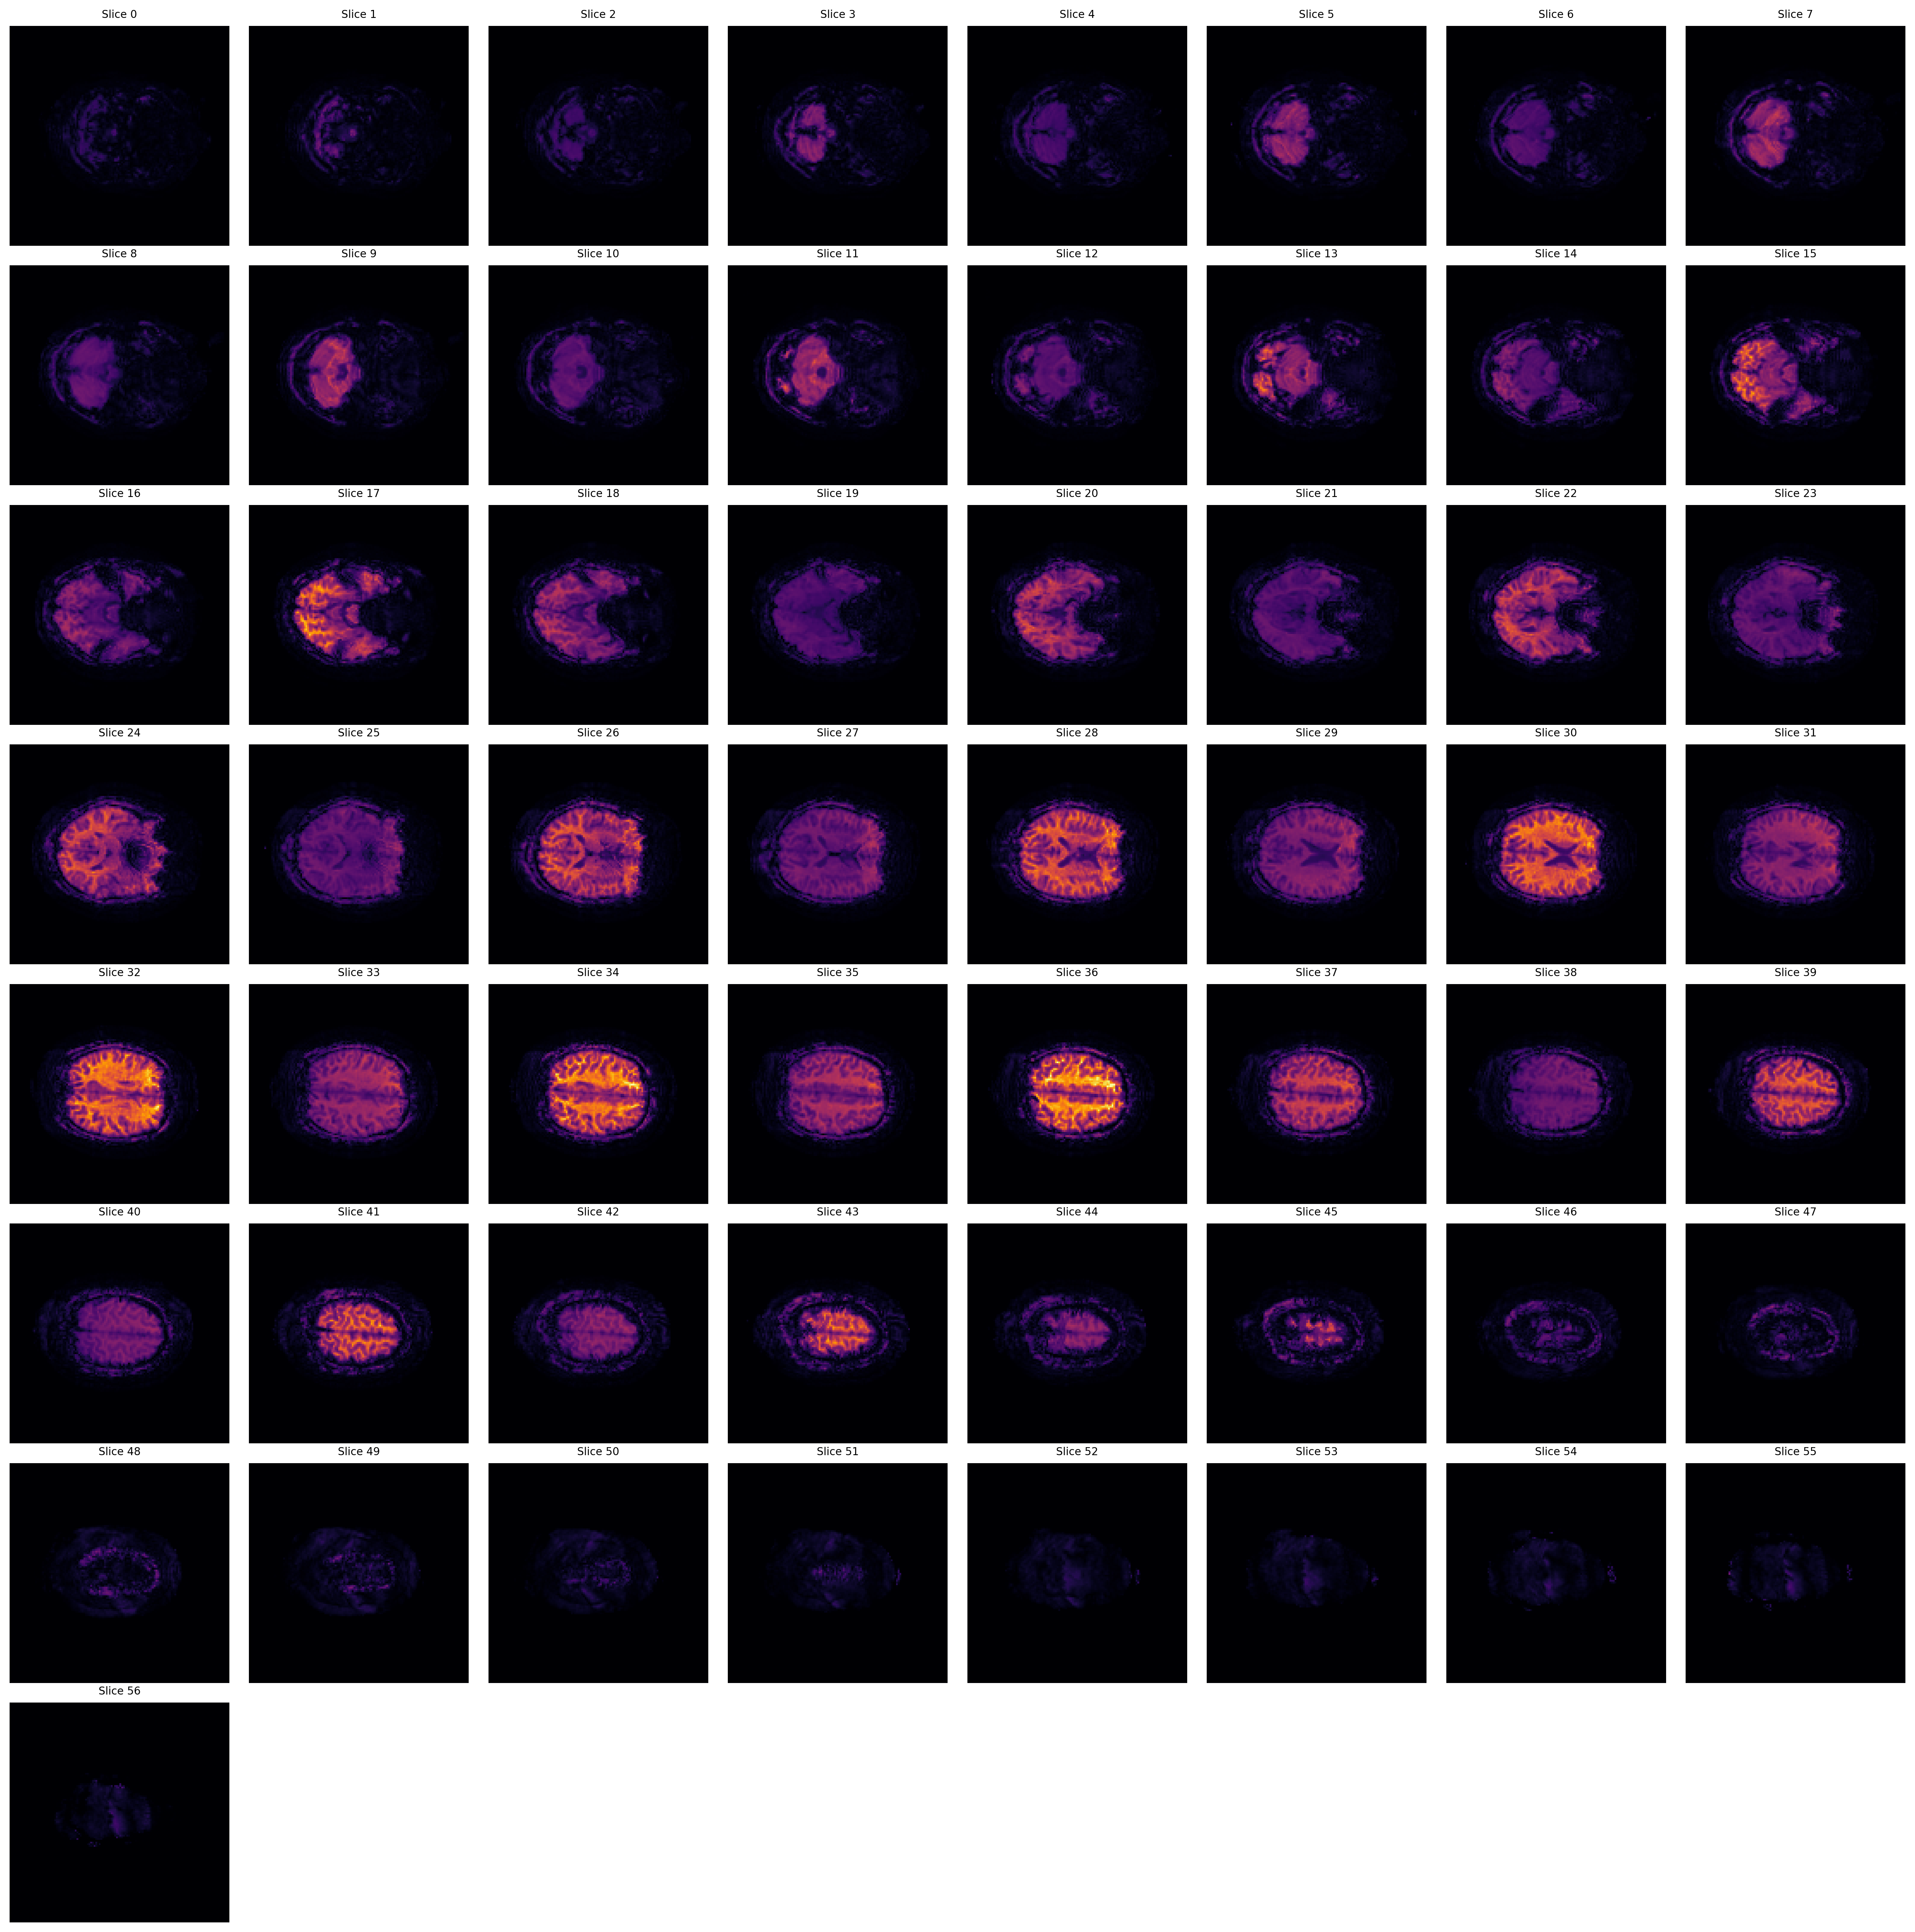
3mm Resolution: Temporal SNR Montage (Orange)
Orange/Red colors indicate higher temporal SNR values. Brighter regions show better signal stability over time.

Slide 31
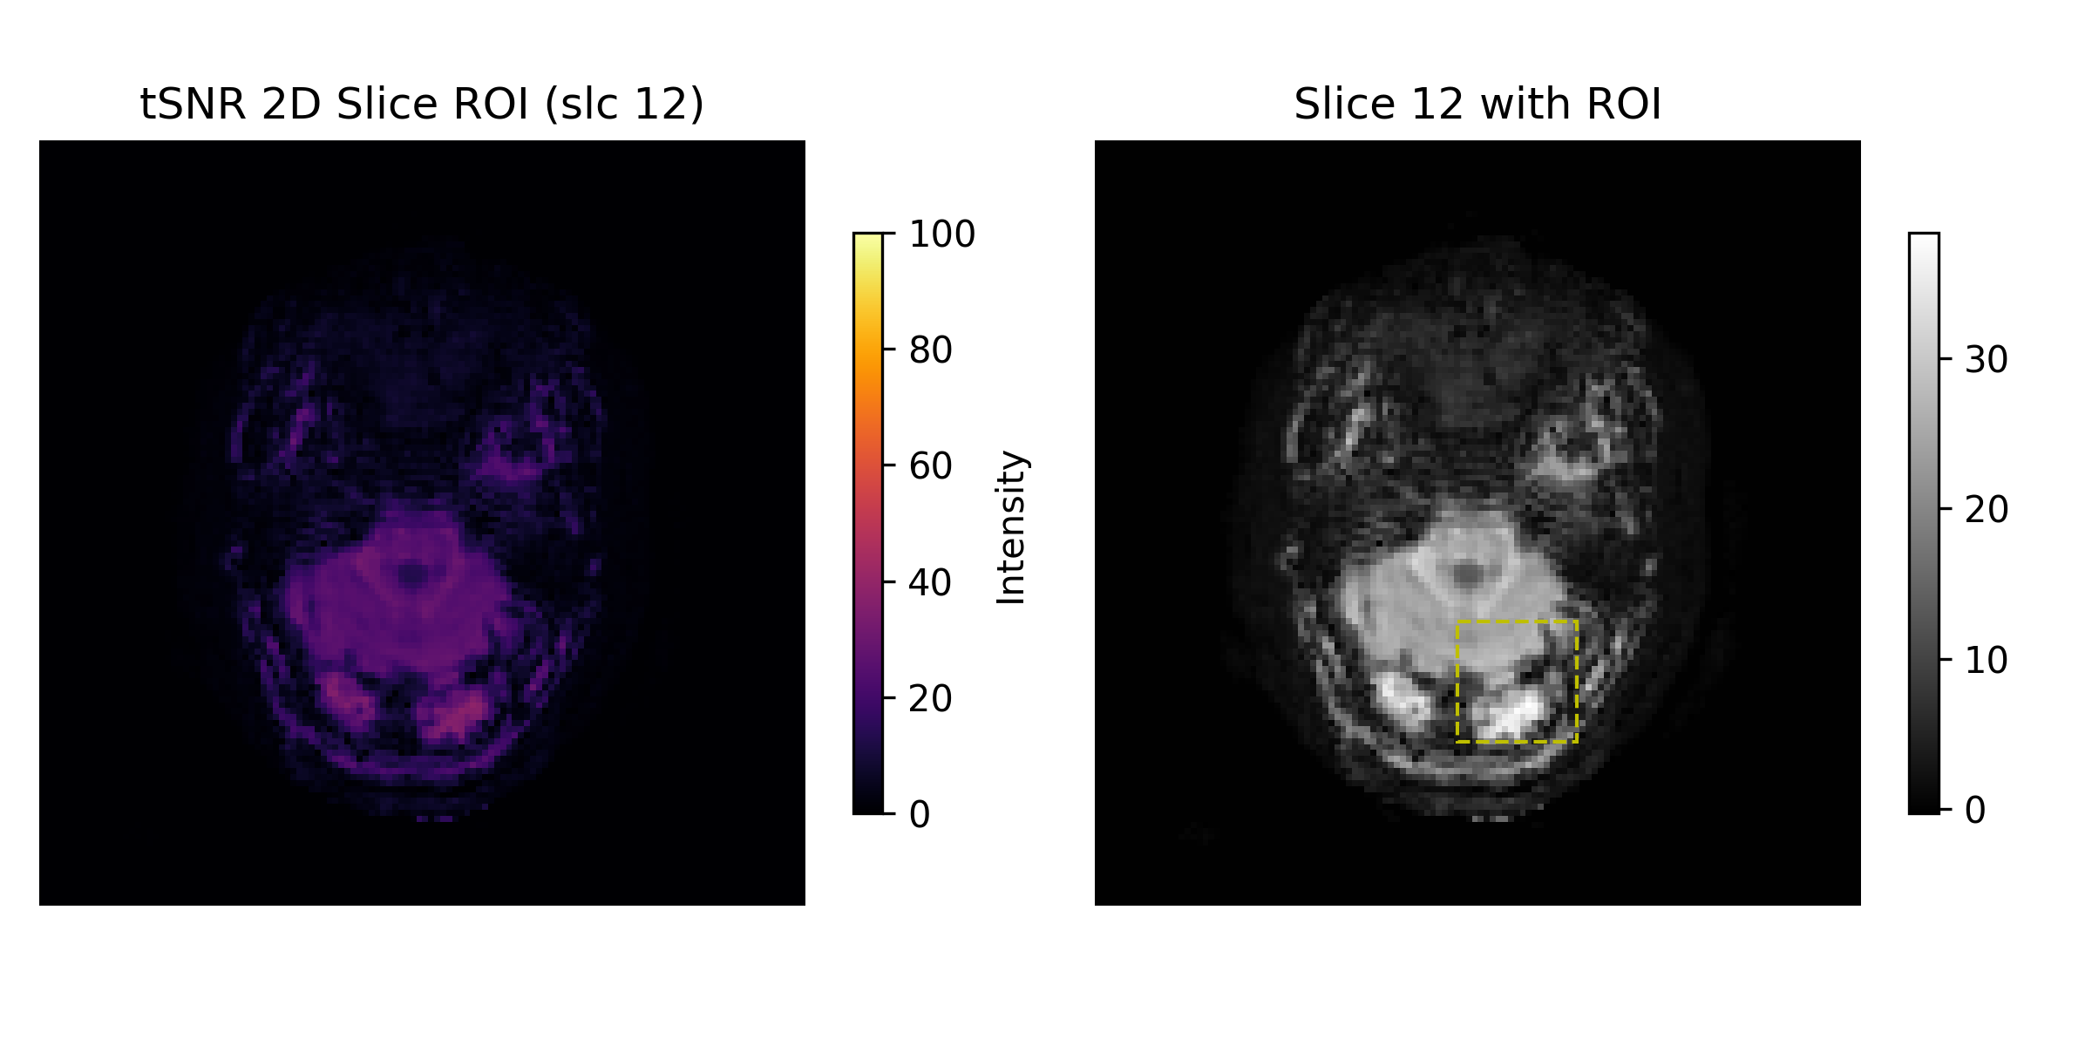
3mm Resolution: tSNR with ROI Analysis
Temporal SNR analysis with Region of Interest overlay showing quantitative measurements.

Slide 32
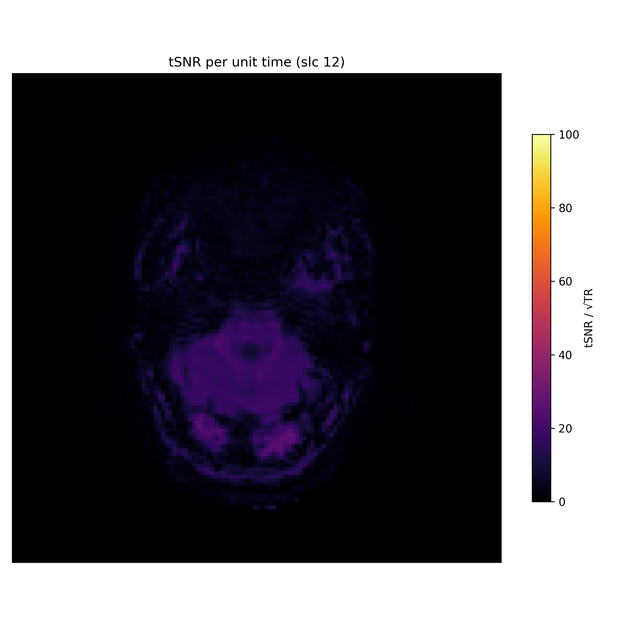
3mm Resolution: tSNR per Unit Time
Temporal SNR normalized per unit time (TR=1.4s). Accounts for different repetition times.

Slide 33
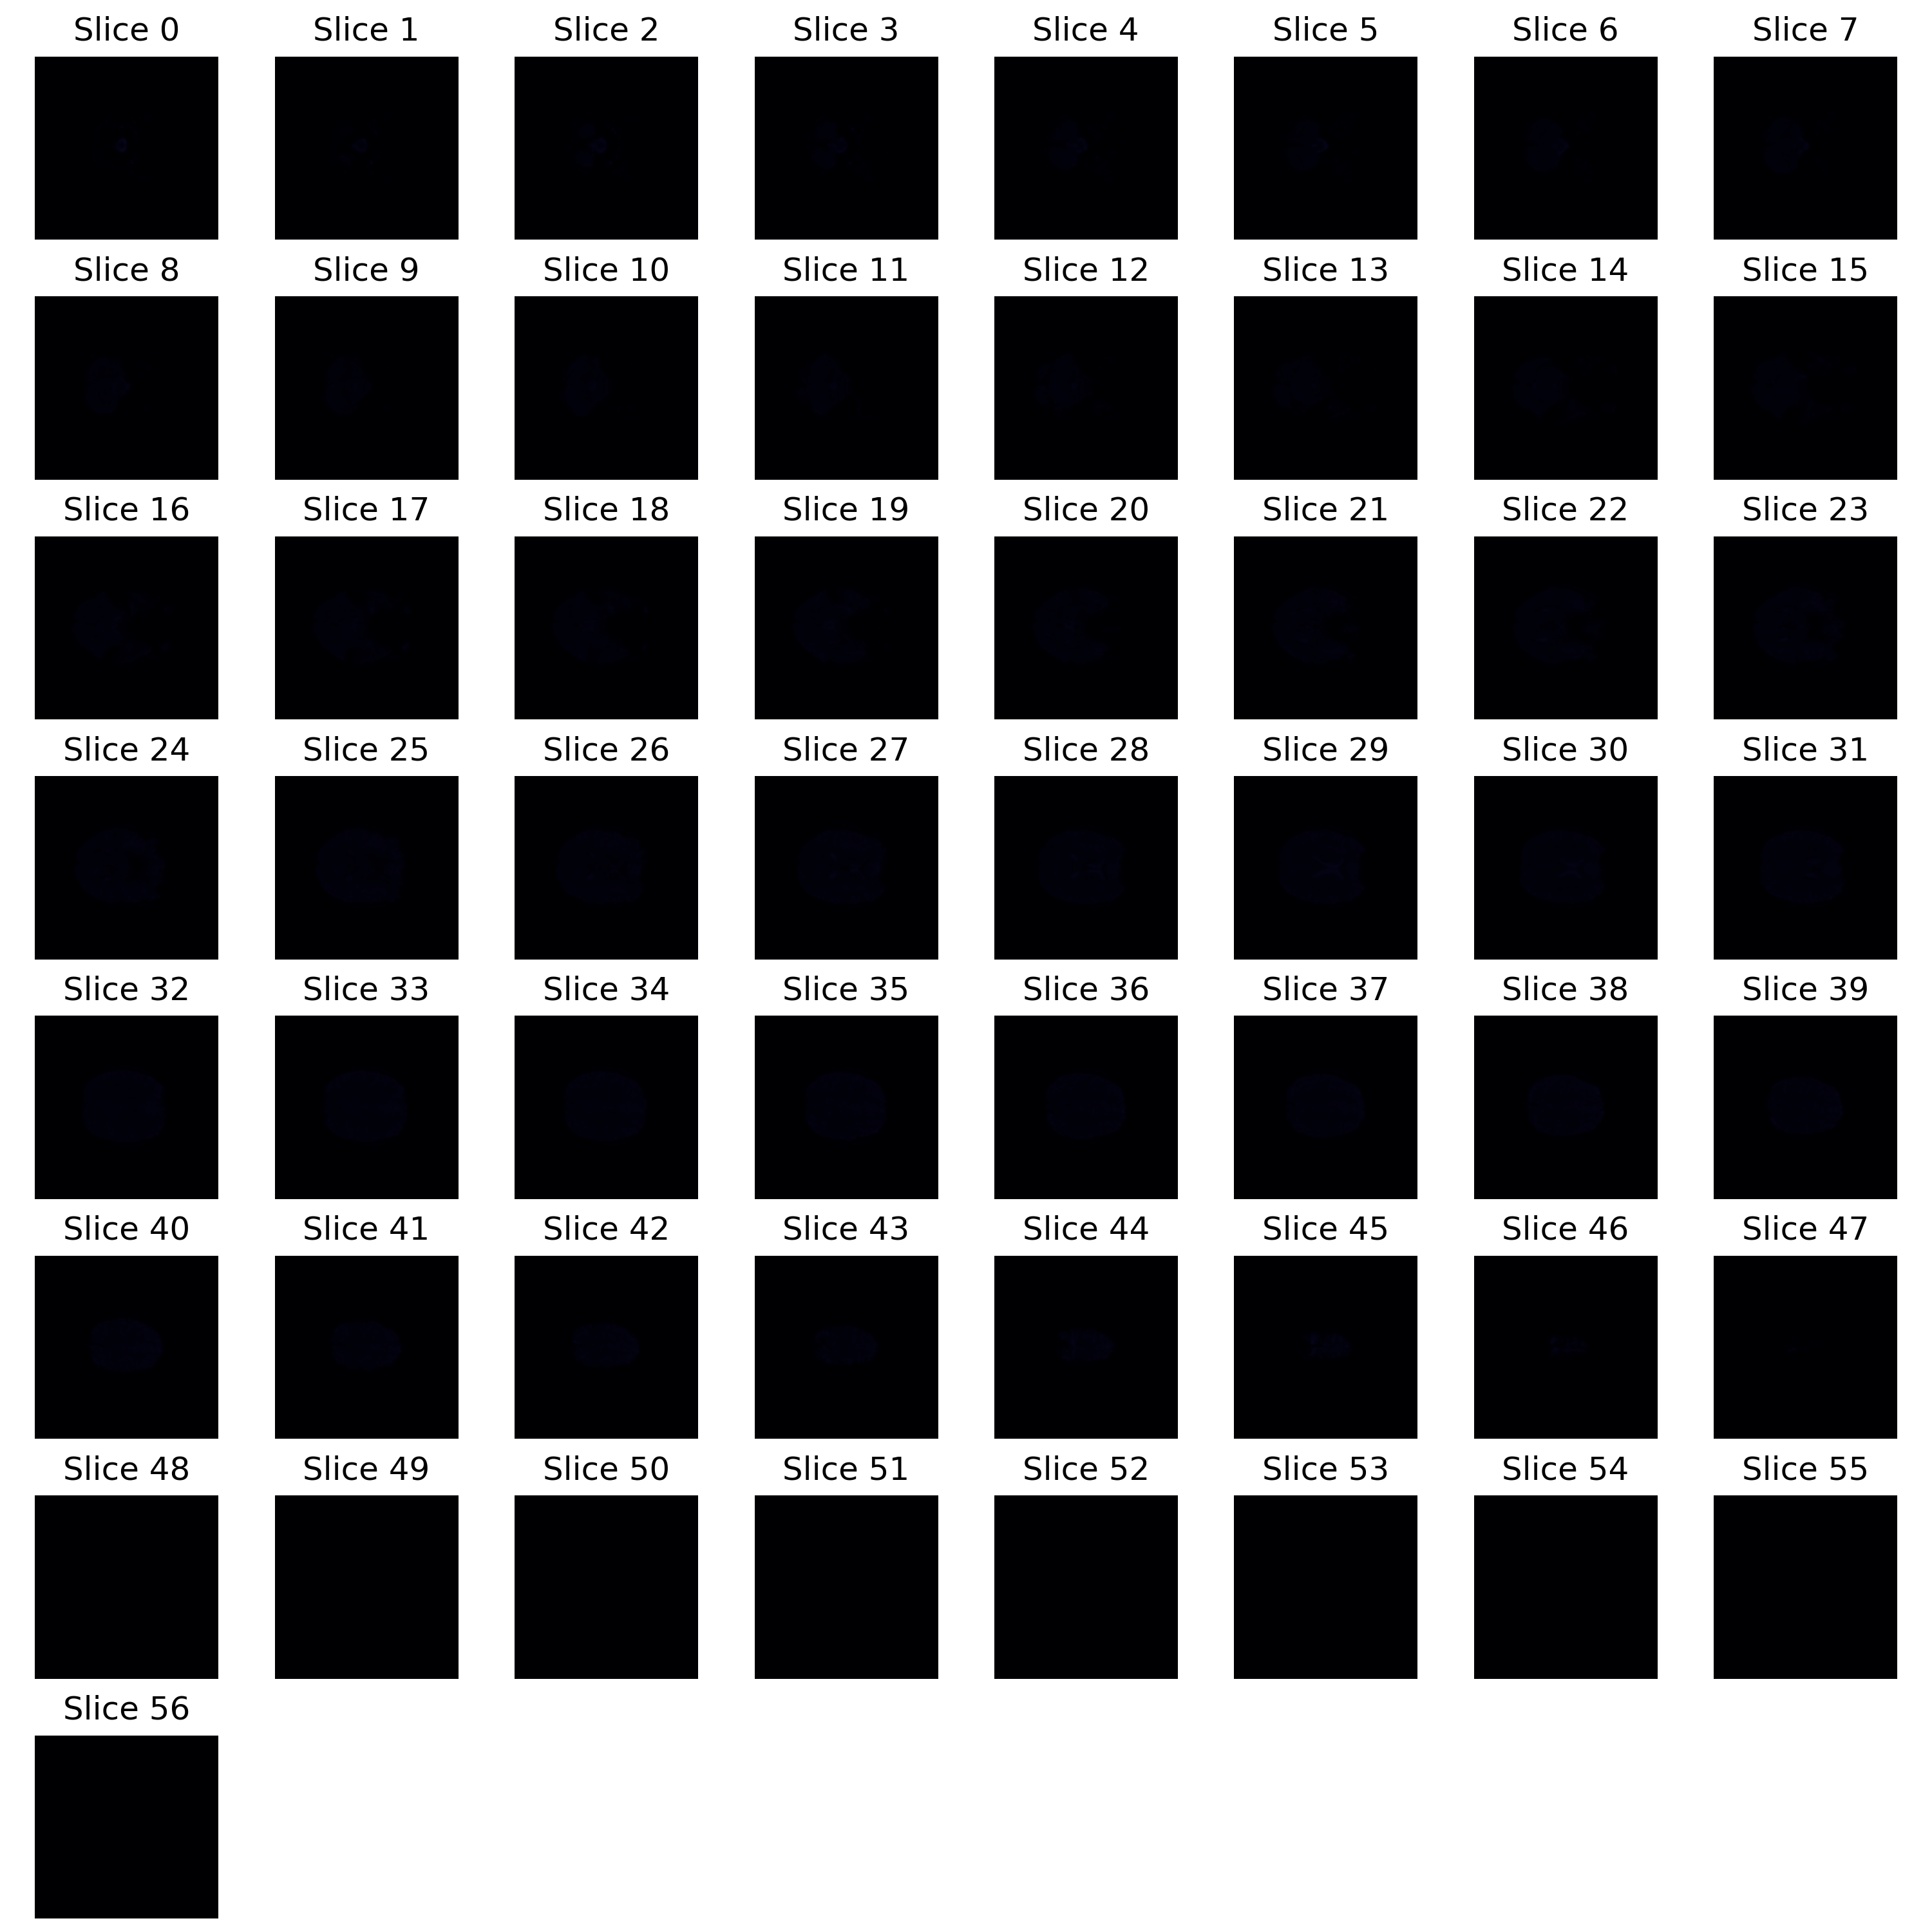
3mm Resolution: Instantaneous SNR Montage
Instantaneous SNR montage showing spatial distribution of signal-to-noise ratio.

Slide 34
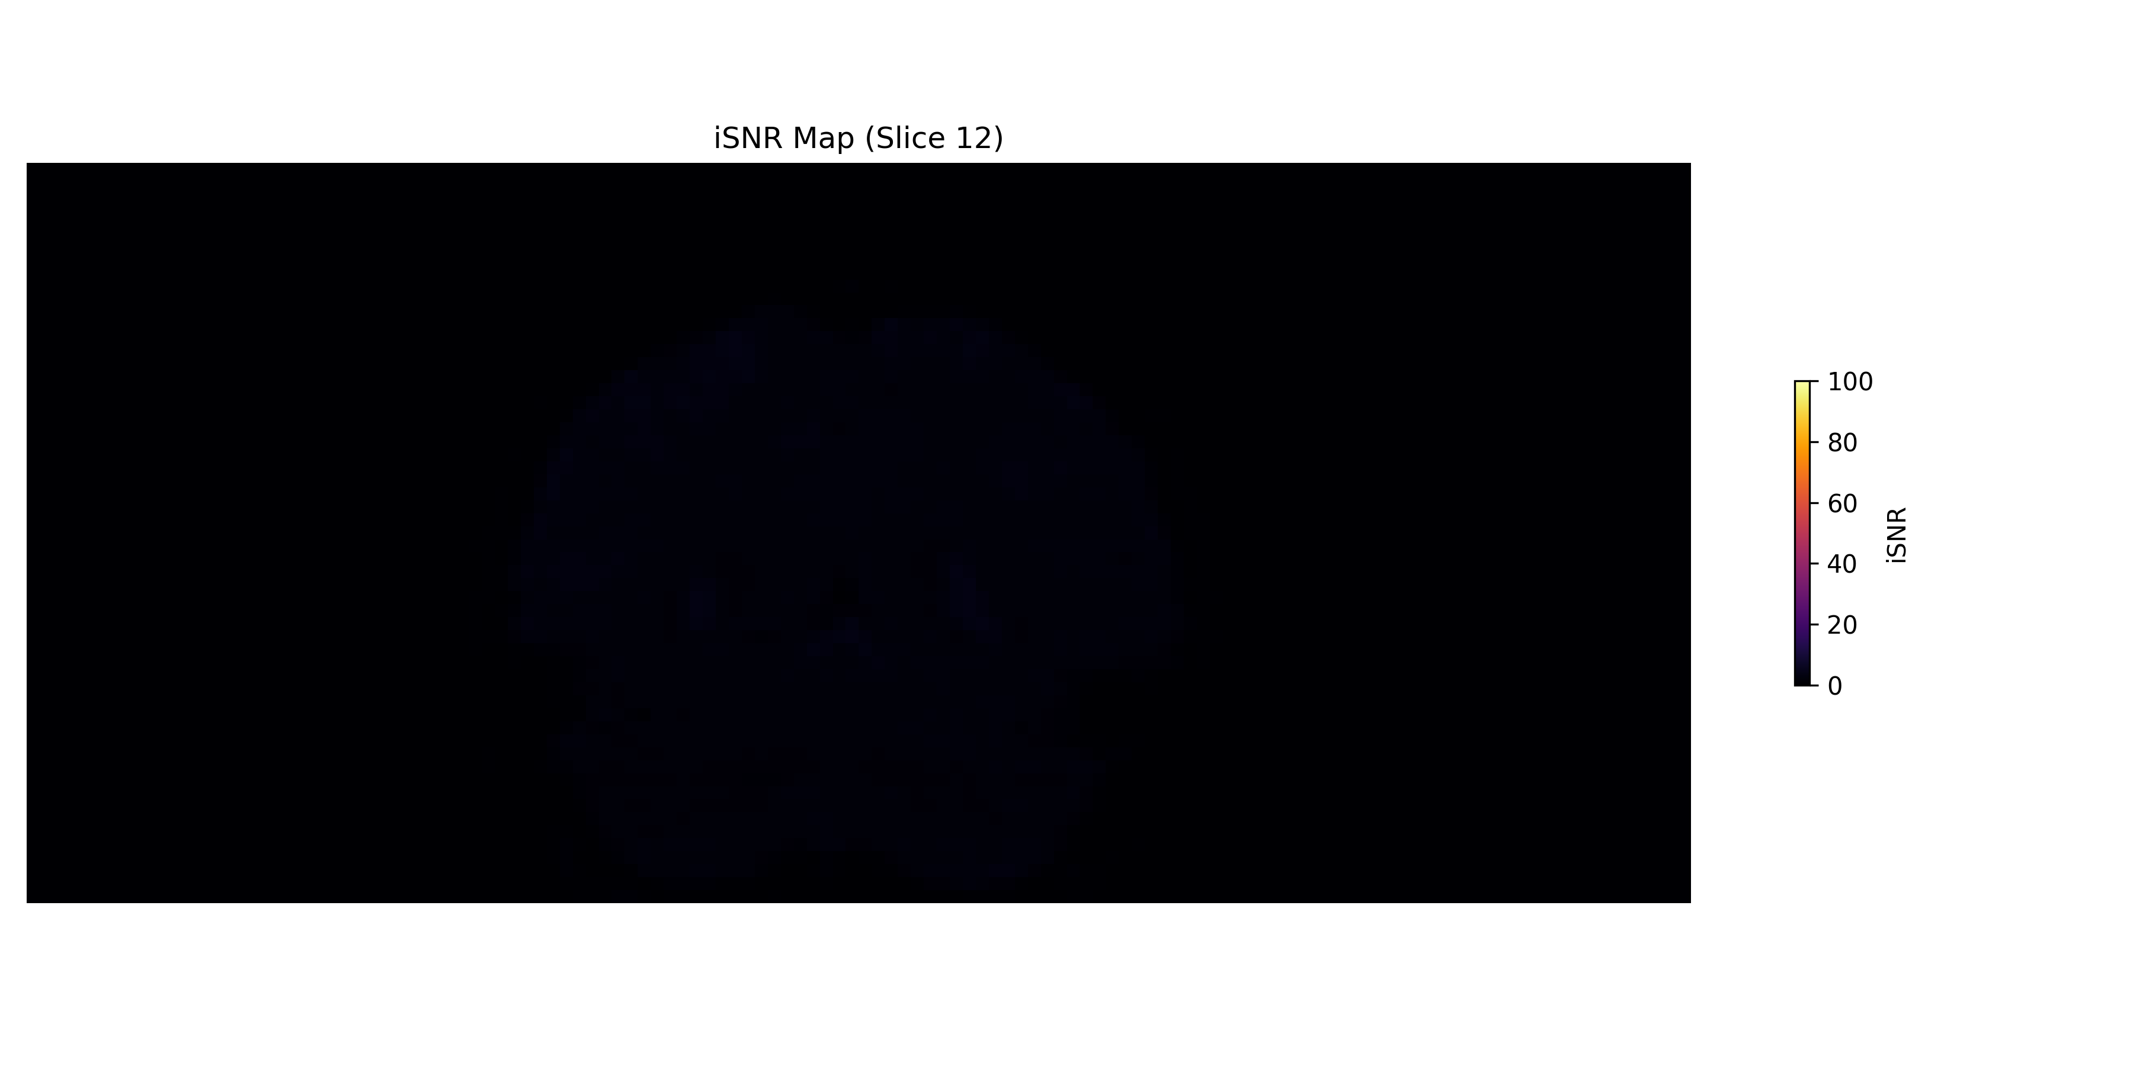
3mm Resolution: iSNR Coronal View

Slide 35
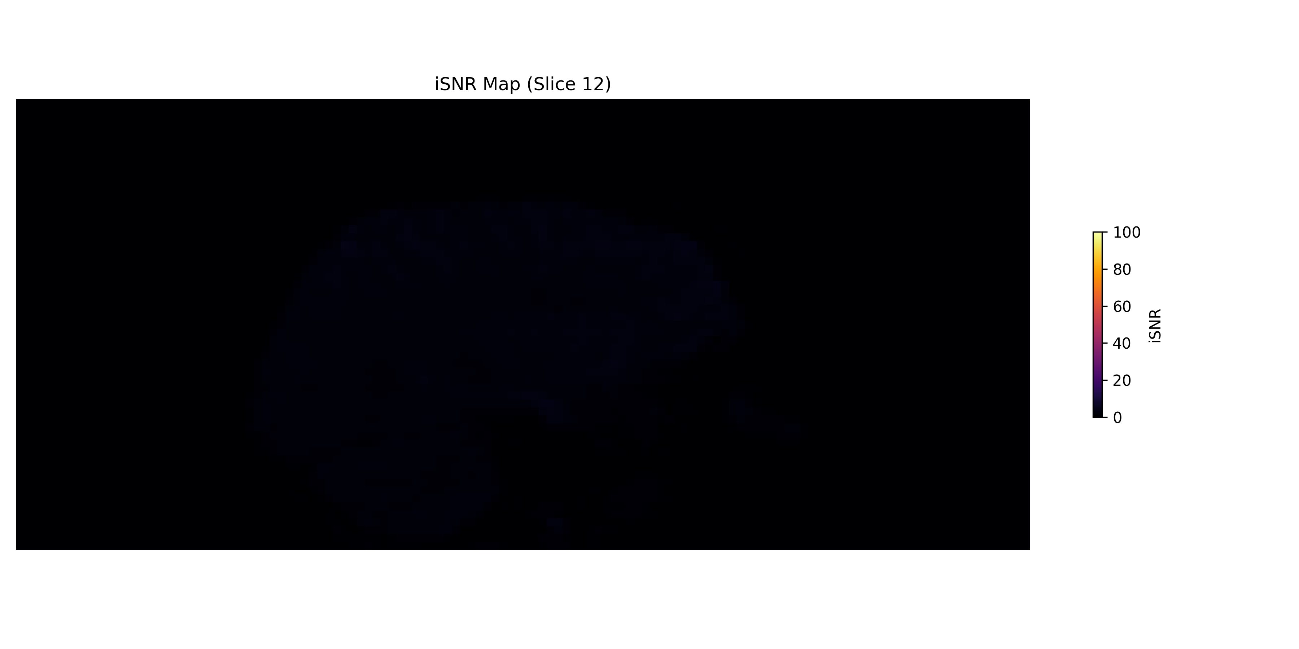
3mm Resolution: iSNR Sagittal View

Slide 36
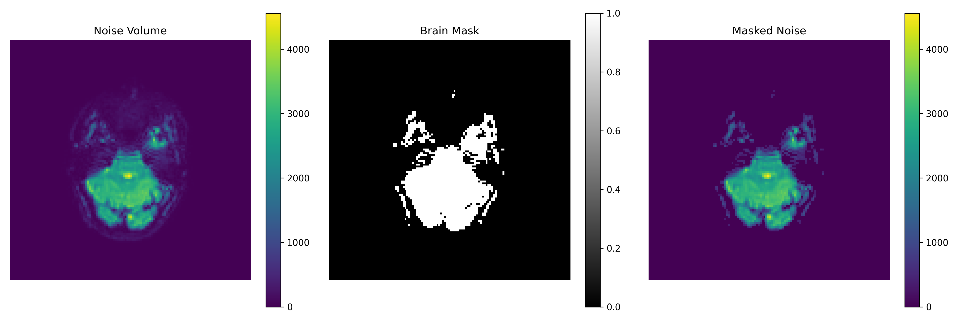
3mm Resolution: Masked Noise Analysis

Slide 37

3mm Resolution: Noise Volume Montage

Slide 38
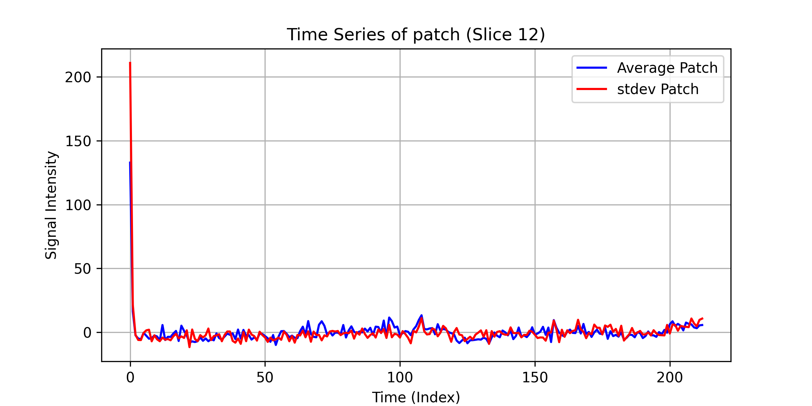
3mm Resolution: Time Series Analysis

Slide 39
2mm Resolution (Pre-scan 1)
TR: 2.026s | 2mm × 2mm × 2mm (Pre-scan 1) | QA Images: 16 | tSNR Images: 6

Slide 40
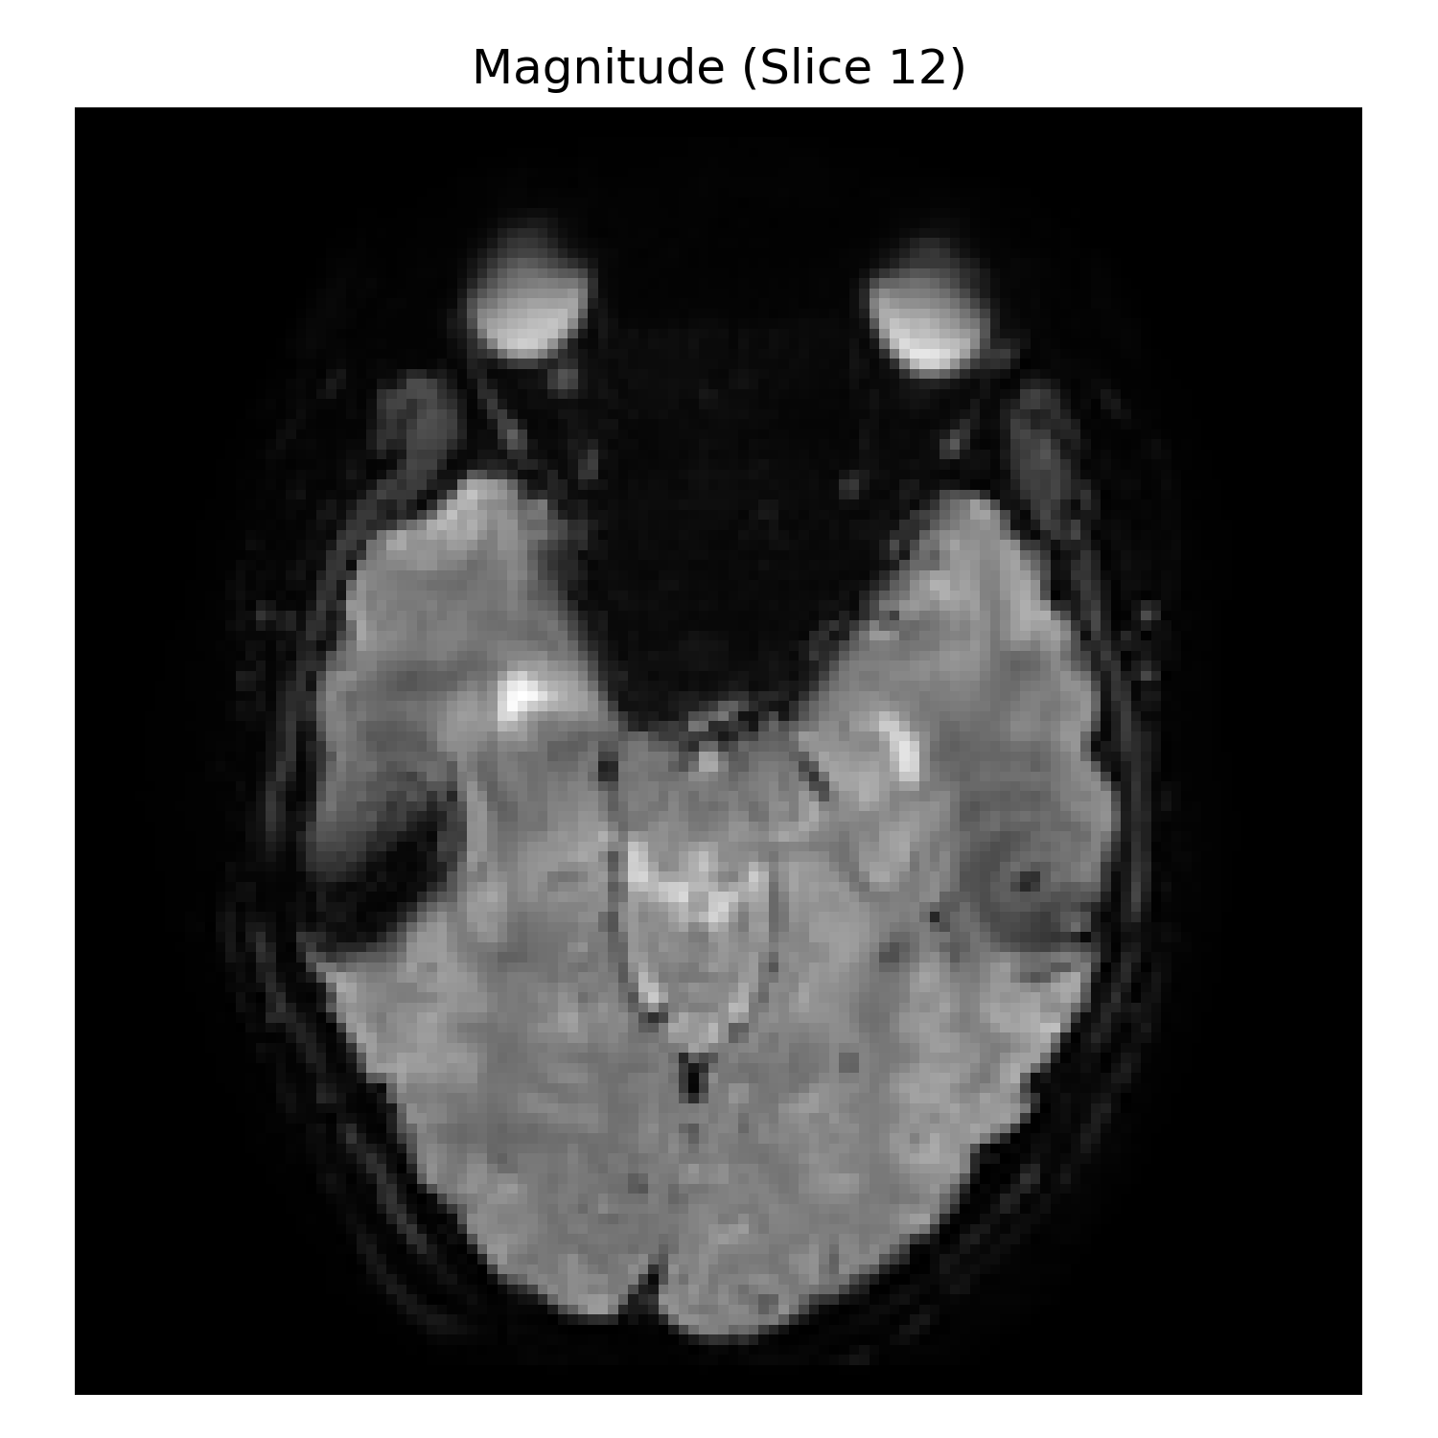
2mm Resolution (Pre-scan 1): Mean Signal Image

Slide 41

2mm Resolution (Pre-scan 1): Mean Signal Montage

Slide 42
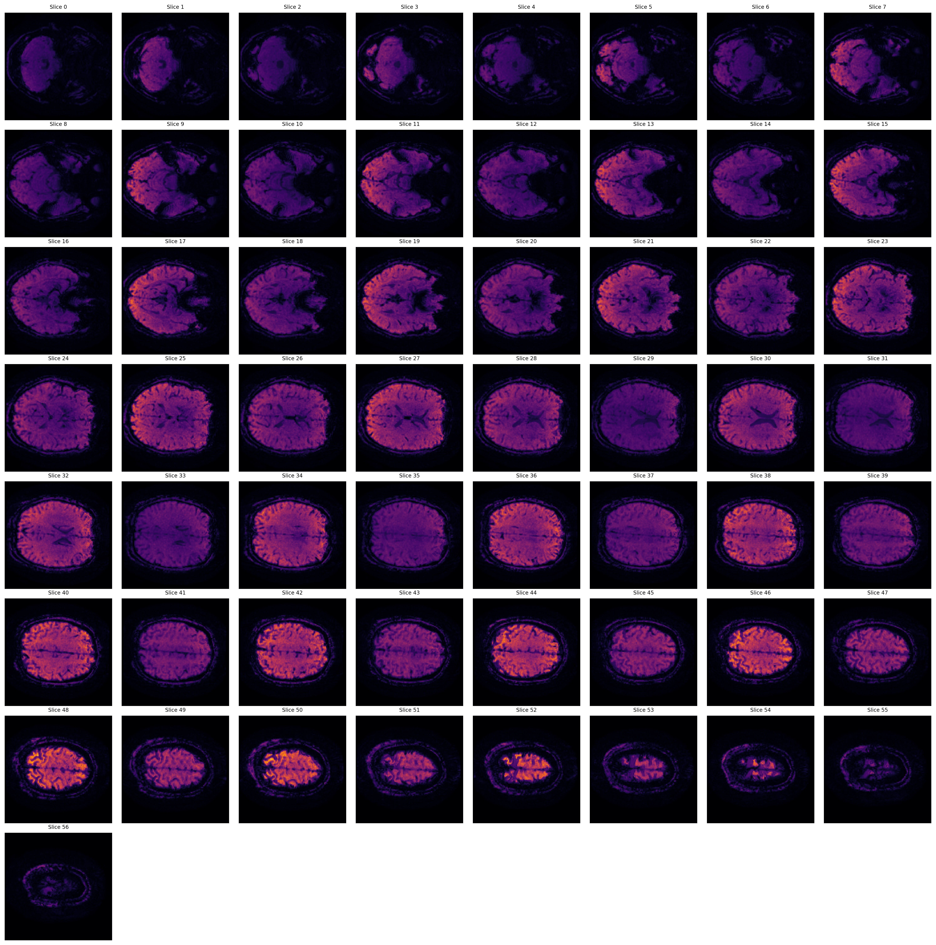
2mm Resolution (Pre-scan 1): Temporal SNR Montage (Orange)
Orange/Red colors indicate higher temporal SNR values. Brighter regions show better signal stability over time.

Slide 43
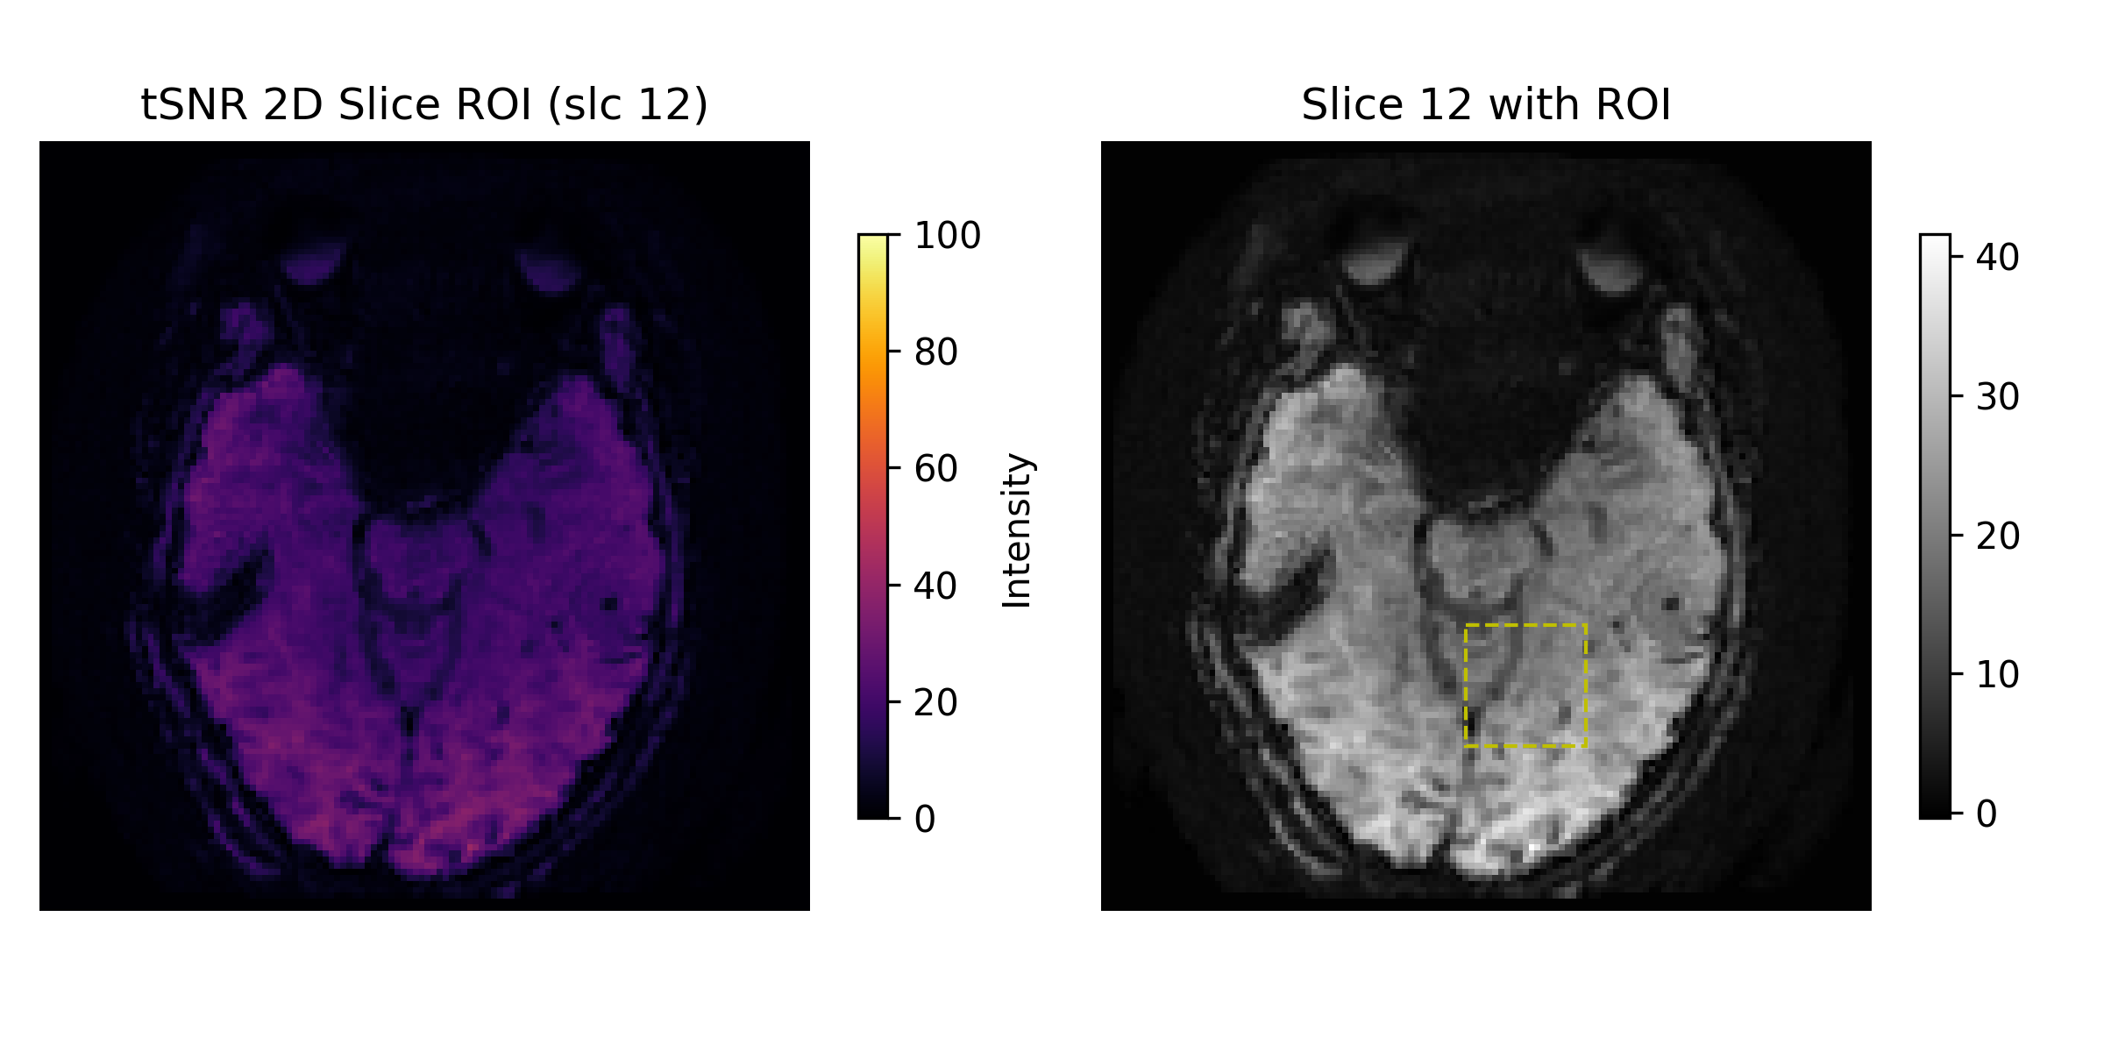
2mm Resolution (Pre-scan 1): tSNR with ROI Analysis
Temporal SNR analysis with Region of Interest overlay showing quantitative measurements.

Slide 44
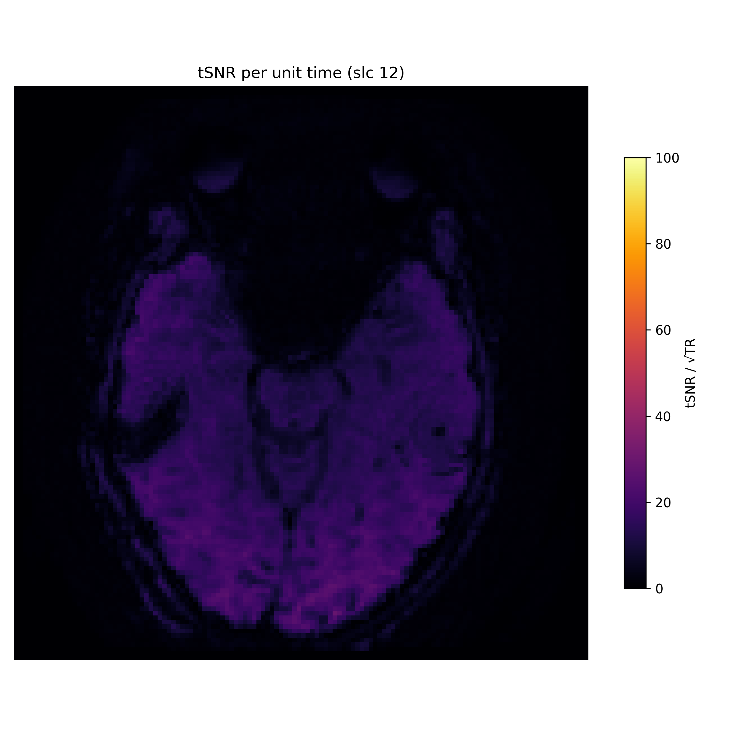
2mm Resolution (Pre-scan 1): tSNR per Unit Time
Temporal SNR normalized per unit time (TR=2.026s). Accounts for different repetition times.

Slide 45
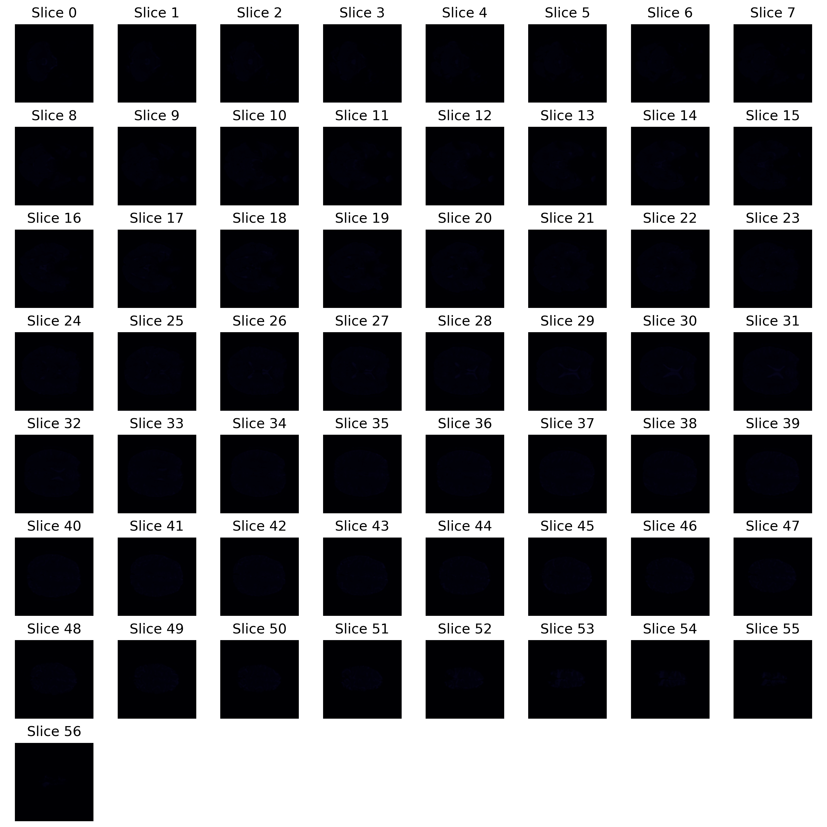
2mm Resolution (Pre-scan 1): Instantaneous SNR Montage
Instantaneous SNR montage showing spatial distribution of signal-to-noise ratio.

Slide 46

2mm Resolution (Pre-scan 1): iSNR Coronal View

Slide 47

2mm Resolution (Pre-scan 1): iSNR Sagittal View

Slide 48
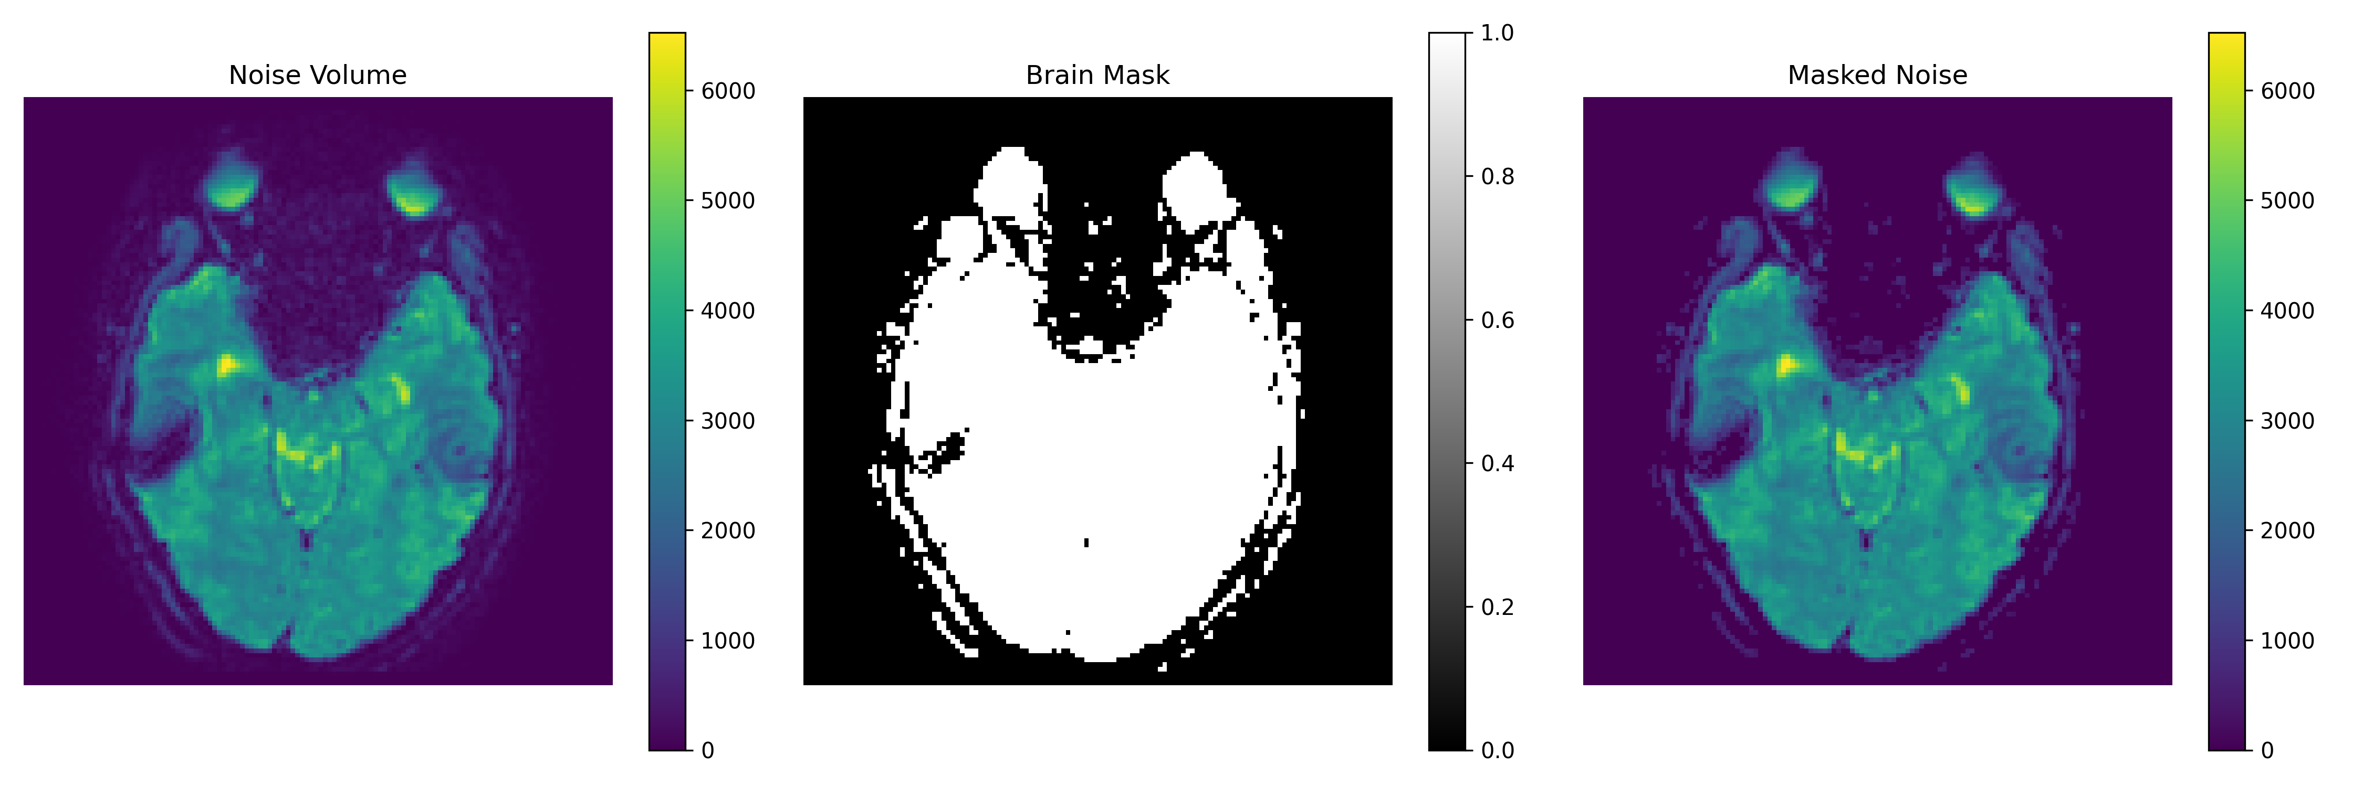
2mm Resolution (Pre-scan 1): Masked Noise Analysis

Slide 49

2mm Resolution (Pre-scan 1): Noise Volume Montage

Slide 50
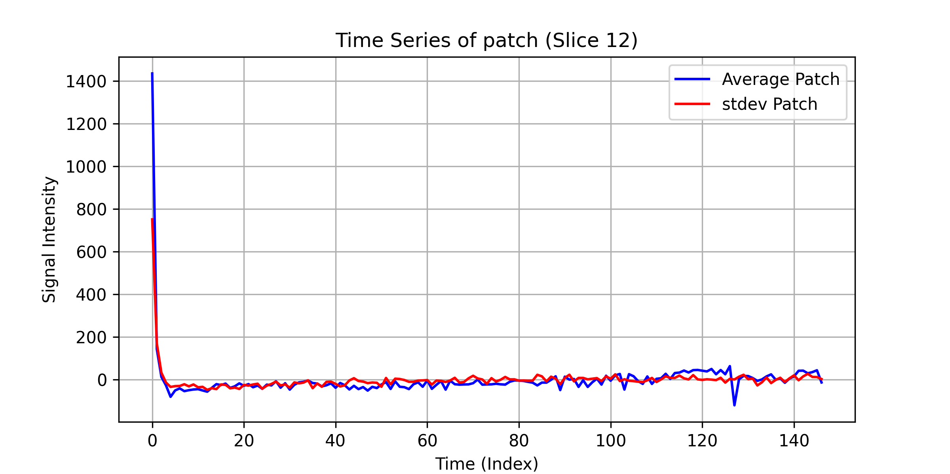
2mm Resolution (Pre-scan 1): Time Series Analysis

